Slide 1
Catalog
1. DBMS Introduction 1···························································································································································································1
2. DBMS Introduction 2·························································································································································································15
3. DBMS ER - Diagrams·······················································································································································································38
4. DBMS EER - Diagrams···················································································································································································· 63
5. DBMS Keys······································································································································································································ 75
6. DBMS Relational Algebra················································································································································································· 91
7. DBMS Functional Dependency·······································································································································································136
8. DBMS Armstrong Axioms (Inference Rules)·················································································································································· 147
9. DBMS Normalization Part 1············································································································································································165
10. DBMS Normalization Part 2··········································································································································································177
11. DBMS Normalization Part 3··········································································································································································192
12. DBMS Transaction Processing·····································································································································································202
13. DBMS Concurrency Control Techniques······················································································································································217
14. DBMS Log Based Recovery········································································································································································· 229
15. DBMS Deadlock··························································································································································································· 237
16. DBMS Serializability····················································································································································································· 247
17. DBMS Distributed Database·········································································································································································260
18. DBMS File Organization··············································································································································································· 270

Slide 2


Database Management System (BCSC-1003)
Topic: Introduction to DBMS
Nikhil Govil
Assistant Professor, Dept. of CEA, GLA University, Mathura.

Slide 3

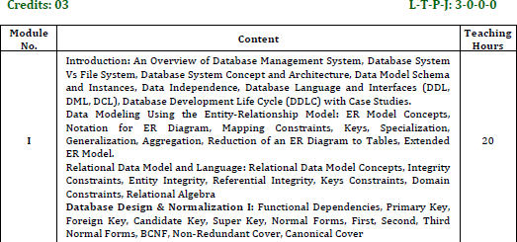
Syllabus

Slide 4
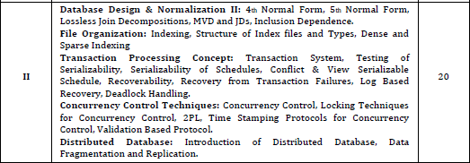
Syllabus

Slide 5
Suggested Books
Text Books:
Elmasri and Navathe, “Fundamentals of Database Systems”, 6th Addision Wesley, 2010.
Edition,
Sadalage, P. & Flower, “NoSQL Distilled: A Brief Guide to the Emerging World of Polyglot Presistence”, Pearson Education, 2012.
Reference Books:
Date C J,” An Introduction to Database Systems”, 8th Edition, Addision Wesley.
Korth, Silbertz and Sudarshan, “Database Concepts”, 5th Edition, TMH, 1998.
Redmond, E. & Wilson, “Seven Databases in Seven Weeks: A Guide to Modern Databases and the NoSQL Movement”, 1st Edition.

Slide 6
Database Management System (DBMS)
A Database Management System (DBMS) is a software designed to store, retrieve, define, and manage data in a database.
DBMS software primarily functions as an interface between the end user and the database, simultaneously managing the data, and the database schema in order to facilitate the organization and manipulation of data.
A database management system functions through the use of system commands, first receiving instructions, then instructing the system accordingly, either to retrieve data, modify data, or load existing data from the system.

Slide 7
Difference Between Data & Information in DBMS
Data is raw, unprocessed, unorganized facts that are seemingly random and do not yet carry any significance or meaning.
Information refers to data that has been organized, interpreted, and contextualized by a human or machine so that it possess relevance and purpose.
Information is filtered data that has been made systematic and useful, and is considered to be more reliable and valuable to researchers as proper analysis and refinement has been conducted.

Slide 8
File System Vs DBMS
File System:
The file system is basically a way of arranging the files in a storage medium like a hard disk.
The file system organizes the files and helps in the retrieval of files when they are required.
File systems consist of different files which are grouped into directories.
The directories further contain other folders and files.
The file system performs basic operations like management, file naming, giving access rules, etc.

Slide 9
File System Vs DBMS
DBMS:
Database Management System is basically software that manages the collection of related data.
It is used for storing data and retrieving the data effectively when it is needed.
It also provides proper security measures for protecting the data from unauthorized access.
In Database Management System the data can be fetched by queries and relational algebra.
It also provides mechanisms for data recovery and data backup.

Slide 10
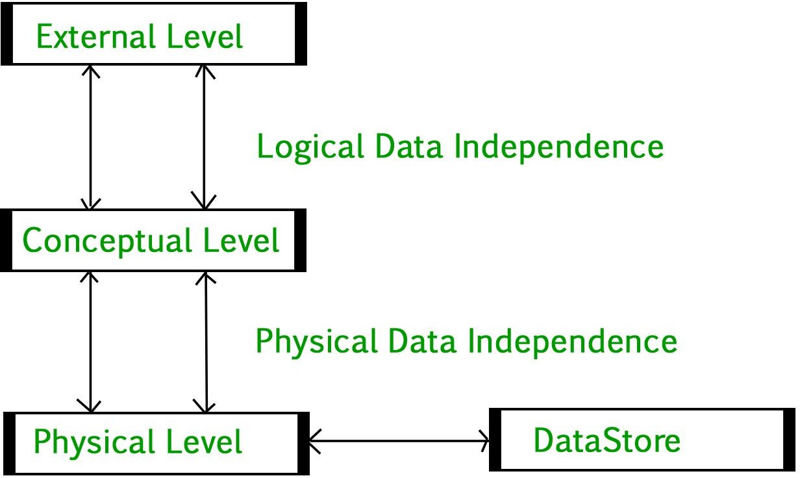
Introduction of 3-Tier Architecture in DBMS
DBMS 3-tier architecture divides the complete system into three inter- related but independent modules as shown below:

Slide 11
Introduction of 3-Tier Architecture in DBMS
Physical Level:
At the physical level, the information about the location of database objects in the data store is kept.
Various users of DBMS are unaware of the locations of these objects.
In simple term, physical level of a database describes how the data is being stored in secondary storage devices like disks and tapes.

Slide 12
Introduction of 3-Tier Architecture in DBMS
Conceptual Level:
At conceptual level, data is represented in the form of various database tables.
For Example, STUDENT database may contain STUDENT and COURSE tables which will be visible to users but users are unaware of their storage.
Also referred as logical schema, it describes what kind of data is to be stored in the database.

Slide 13
Introduction of 3-Tier Architecture in DBMS
External Level:
An external level specifies a view of the data in terms of conceptual level tables.
Each external level view is used to cater to the needs of a particular category of users.
For Example, FACULTY of a university is interested in looking course details of students, STUDENTS are interested in looking at all details related to academics, accounts, courses and hostel details as well.
So, different views can be generated for different users.
The main focus of external level is data abstraction.

Slide 14
References
Korth, Silbertz and Sudarshan (1998), “Database Concepts”, 5th Edition, TMH.
Elmasri and Navathe (2010), “Fundamentals of Database Systems”, 6th Edition, Addision Wesley.
Date C J,” An Introduction to Database Systems”, 8th Edition, Addision Wesley.
M. Tamer Oezsu, Patrick Valduriez (2011). “Principles of Distributed Database Systems”, 2nd Edition, Prentice Hall.

Slide 16
Database Management System (BCSC-1003)
Topic: Introduction to DBMS
Nikhil Govil
Assistant Professor, Dept. of CEA, GLA University, Mathura.

Slide 17
Content
Difference between Schema and Instance in DBMS
Data Independence
Database Models
DBMS Vs RDBMS

Slide 18
Difference between Schema and Instance in DBMS

Slide 19
Difference between Schema and Instance in DBMS
Instances:
Instances are the collection of information stored at a particular moment.
The instances can be changed by certain CRUD (Create, Read, Update, Delete) operations as like addition, deletion of data.
Example –
Let’s say a table TEACHER in our database whose name is SCHOOL, suppose the table has 50 records so the instance of the database has 50 records for now and tomorrow we are going to add another fifty records so tomorrow the instance have total 100 records. This is called an instance.

Slide 20
Difference between Schema and Instance in DBMS
Schema :
Schema is the overall description of the database.
The basic structure of how the data will be stored in the database is called schema.
Example –
Let’s say a table named TEACHER in our database name SCHOOL, the TEACHER table require the name, dob, doj in the table so we design a structure as :
TEACHER
name: varchar doj: date dob: date
Above given is the schema of the table TEACHER.

Slide 21
Data Independence

Slide 22
Data Independence
Data independence can architecture.
be explained using the three-schema
Data independence refers characteristic of being able to modify the schema at one level of the database system without altering the schema at the next higher level.
There are two types of data independence:
Logical Data Independence and
Physical Data Independence

Slide 23
Data Independence
Logical Data Independence:
Logical data independence refers characteristic of being able to change the conceptual schema without having to change the external schema.
Logical data independence is used to separate the external level from the conceptual view.
If we do any changes in the conceptual view of the data, then the user view of the data would not be affected.
Logical data independence occurs at the user interface level.

Slide 24
Data Independence
Physical Data Independence:
Physical data independence can be defined as the capacity to change the internal schema without having to change the conceptual schema.
If we do any changes in the storage size of the database system server, then the conceptual structure of the database will not be affected.
Physical data independence is used to separate conceptual levels from the internal levels.
Physical data independence occurs at the logical interface level.

Slide 25
Database Models

Slide 26
Database Models
Data Model gives us an idea that how the final system will look like after its complete implementation.
It defines the data elements and the relationships between the data elements.
Data Models are used to show how data is stored, connected, accessed and updated in the DBMS.
Some of the Data Models in DBMS are:
Hierarchical Model,
Entity-Relationship Model, Flat Data Model,
Context Data Model,
Object-Relational Data Model,
Network Model, Relational Model,
Object-Oriented Data Model,
Associative Data Model,
Semi-Structured Data Model etc.

Slide 27
Database Models
Hierarchical Model:
Hierarchical Model was the first DBMS model.
This model organizes the data in the hierarchical tree structure.
The hierarchy starts from the root which has root data and then it expands in the form of a tree adding child node to the parent node.
This model easily represents some of the real-world relationships like hierarchy of any organization, sitemap of a website etc.

Slide 28
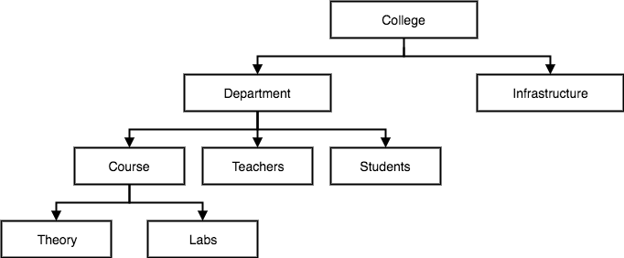
Database Models
Example:

Slide 29
Database Models
Network Model
This model is an extension of the hierarchical model.
It was the most popular model before the relational model.
This model is the same as the hierarchical model, the only difference is that a record can have more than one parent.
It replaces the hierarchical tree with a graph.

Slide 30
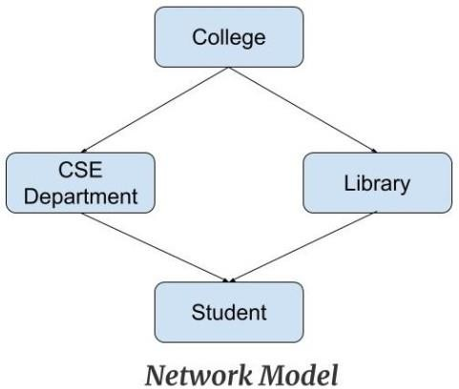
Database Models
Example: In the example below we can see that node student has two parents i.e. CSE Department and Library. This was earlier not possible in the hierarchical model.

Slide 31
Database Models
Entity-Relationship Model
Entity-Relationship Model or simply ER Model is a high-level data model diagram.
In this model, we represent the real-world problem in the pictorial form to make it easy for the stakeholders to understand.
It is also very easy for the developers to understand the system by just looking at the ER diagram.
We use the ER diagram as a visual tool to represent an ER Model.
ER diagram has the following three components: Entity, Attribute and Relationship.

Slide 32
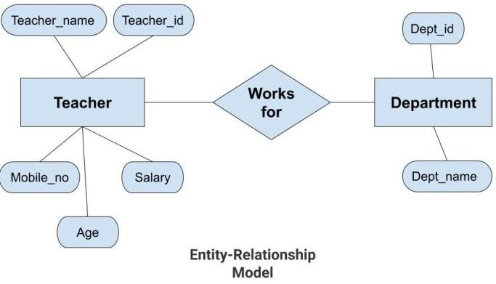
Database Models

Slide 33
Database Models
Relational Model
This model was introduced by Dr. E. F. Codd in 1970.
Relational Model is the most widely used model.
In this model, the data is maintained in the form dimensional table.
of a two-
All the information is stored in the form of rows and columns.
The basic structure of a relational model is tables.
So, the tables are also called relations in the relational model.

Slide 34
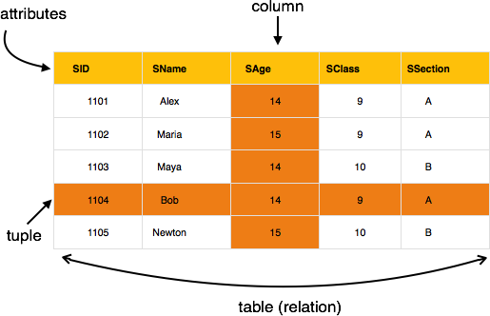
Database Models

Slide 35
DBMS Vs RDBMS

Slide 36
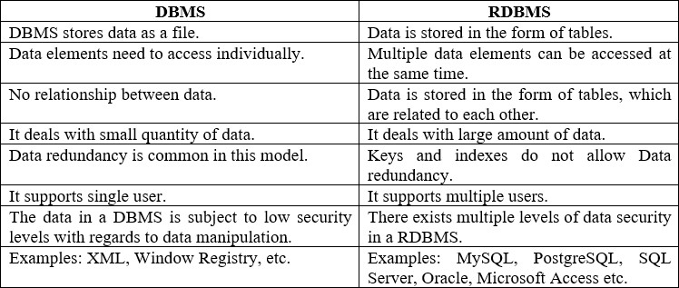
DBMS Vs RDBMS
The below table demonstrates the main difference between RDBMS and DBMS:

Slide 37

References
Korth, Silbertz and Sudarshan (1998), “Database Concepts”, 5th Edition, TMH.
Elmasri and Navathe (2010), “Fundamentals of Database Systems”, 6th Edition, Addision Wesley.
Date C J,” An Introduction to Database Systems”, 8th Edition, Addision Wesley.
M. Tamer Oezsu, Patrick Valduriez (2011). “Principles of Distributed Database Systems”, 2nd Edition, Prentice Hall.
https://www.geeksforgeeks.org/difference-between-schema-and- instance-in-dbms/last accessed on 10 December 2021.
https://www.javatpoint.com/dbms-data-independence/last accessed on 10 December 2021.

Slide 39
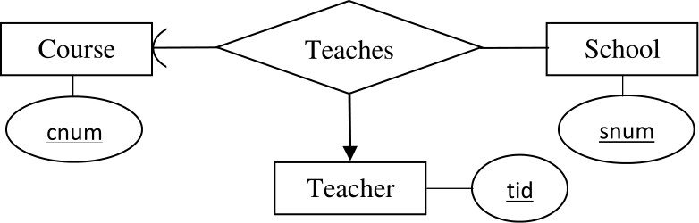
Database Management Systems (BCSC-0003)
Topic: E–R Diagrams
Nikhil Govil
Assistant Professor, Dept. of CEA, GLA University, Mathura.

Slide 40
E–R Diagram
E–R diagram stands for Entity Relationship Diagram.
Entity–relationship modeling was developed for database and design by Peter Chen in 1976.
An E–R diagram shows the relationship among entity sets.
An entity set is a group of similar entities and these entities can have attributes.
In terms of DBMS, an entity is a table.
By showing relationship among tables and their attributes, E–R diagram shows the complete logical structure of a database.

Slide 41
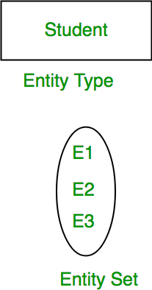
Introduction of E–R Model
ER Model is used to model the logical view of the system from data perspective which consists of these components:
Entity, Entity Type, Entity Set:
An Entity may be an object with a physical existence – a particular person, car, house, or employee – or it may be an object with a conceptual existence – a company, a job, or a university course.
An Entity is an object of Entity Type and set of all entities is called as entity set. e.g.; E1 is an entity having Entity Type Student and set of all students is called Entity Set. In ER diagram, Entity Type is represented as:

Slide 42

Introduction of E–R Model
Attribute:
Attributes are the properties which define the entity type. For example, Roll_No, Name, DOB, Age, Address, Mobile_No are the attributes which defines entity type Student. In ER diagram, attribute is represented by an oval.

Slide 43
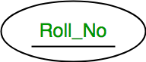
Introduction of E–R Model
1. Key Attribute –
The attribute which uniquely identifies each entity in the entity set is called key attribute. For example, Roll_No will be unique for each student. In ER diagram, key attribute is represented by an oval with underlying lines.

Slide 44
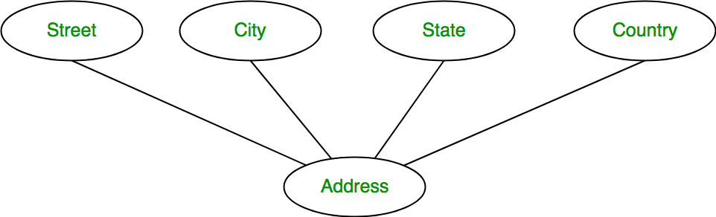
Introduction of E–R Model
2. Composite Attribute –
An attribute composed of many other attribute is called as composite attribute. For example, Address attribute of student Entity type consists of Street, City, State, and Country. In ER diagram, composite attribute is represented by an oval comprising of ovals.

Slide 45

Introduction of E–R Model
3. Multivalued Attribute –
An attribute consisting more than one value for a given entity. For example, Phone_No (can be more than one for a given student). In ER diagram, multivalued attribute is represented by double oval.

Slide 46

Introduction of E–R Model
4. Derived Attribute –
An attribute which can be derived from other attributes of the entity type is known as derived attribute. e.g.; Age (can be derived from DOB). In ER diagram, derived attribute is represented by dashed oval.

Slide 47
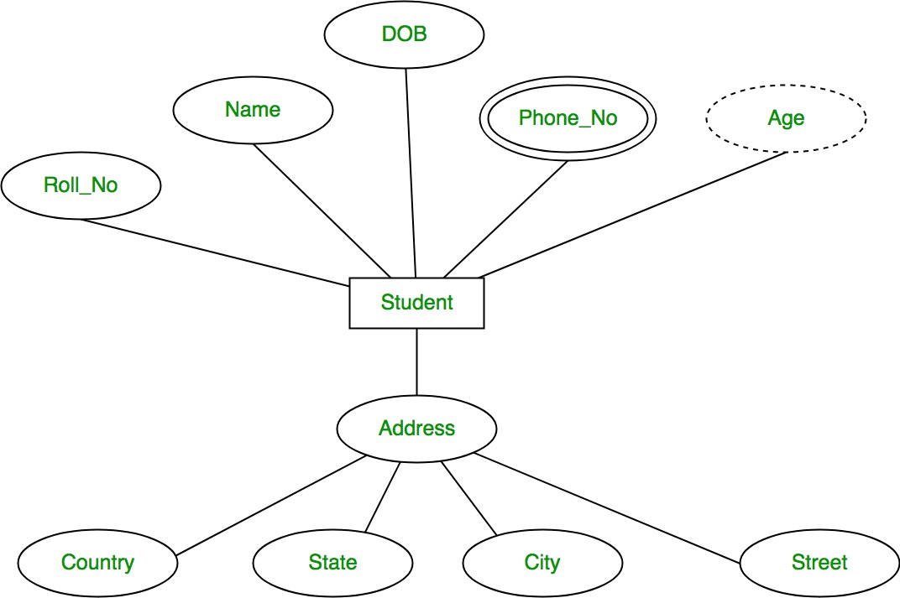
Introduction of E–R Model
The complete entity type Student with its attributes can be represented as:

Slide 48
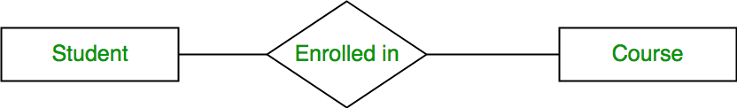
Introduction of E–R Model
Relationship Type and Relationship Set:
A relationship type represents the association between entity types. For example, ‘Enrolled in’ is a relationship type that exists between entity type Student and Course. In ER diagram, relationship type is represented by a diamond and connecting the entities with lines.

Slide 49
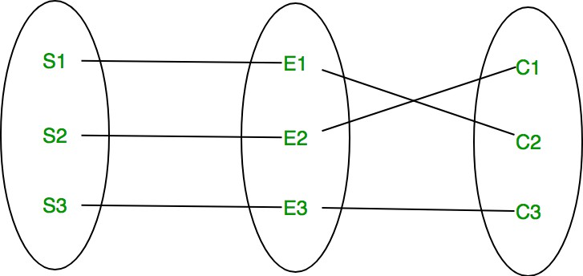
Introduction of E–R Model
A set of relationships of same type is known as relationship set. The following relationship set depicts S1 is enrolled in C2, S2 is enrolled in C1 and S3 is enrolled in C3.

Slide 50
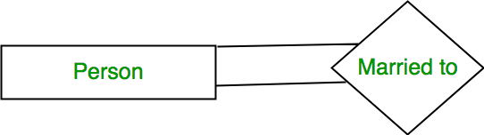
Introduction of E–R Model
Degree of a relationship set:
The number of different entity sets participating in a relationship set is called as degree of a relationship set.
1. Unary Relationship –
When there is only ONE entity set participating in a relation, the relationship is called as unary relationship. For example, one person is married to only one person.

Slide 51
Introduction of E–R Model
2. Binary Relationship –
When there are TWO entities set participating in a relation, the relationship is called as binary relationship. For example, Student is enrolled in Course.

Slide 52
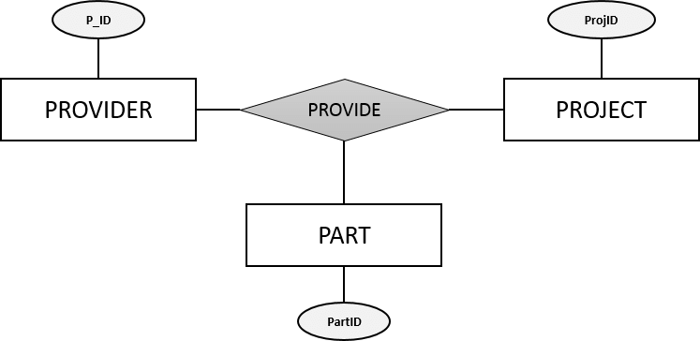
Introduction of E–R Model
3. n-ary Relationship –
When there are n entities set participating in a relation, the relationship is called as n-ary relationship.
Cardinality:
The number of times an entity of an entity set participates in a relationship set is known as cardinality. Cardinality can be of different types as:
One to One Relationship
One to Many Relationship
Many to One Relationship &
Many to Many Relationship

Slide 53


Introduction of E–R Model
A. One to One Relationship – When a single instance of an entity is associated with a single instance of another entity then it is called one to one relationship. For example, a person has only one passport and a passport is given to one person.
B. One to Many Relationship – When a single instance of an entity is associated with more than one instances of another entity then it is called one to many relationship. For example – a customer can place many orders but a order cannot be placed by many customers.

Slide 54


Introduction of E–R Model
C. Many to One Relationship – When more than one instances of an entity is associated with a single instance of another entity then it is called many to one relationship. For example – many students can study in a single college but a student cannot study in many colleges at the same time.
D. Many to Many Relationship – When more than one instances of an entity is associated with more than one instances of another entity then it is called many to many relationship. For example, a student can be assigned to many projects and a project can be assigned to many students.

Slide 55
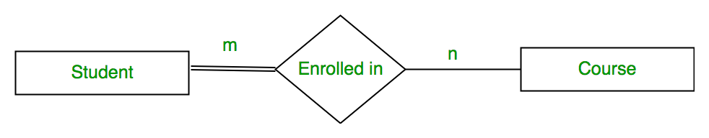
Introduction of E–R Model
Participation Constraint:
Participation Constraint is applied on the entity participating in the relationship set.
Total Participation – Each entity in the entity set must participate in the relationship. If each student must enroll in a course, the participation of student will be total. Total participation is shown by double line in ER diagram.
Partial Participation – The entity in the entity set may or may NOT participate in the relationship. If some courses are not enrolled by any of the student, the participation of course will be partial.
The diagram depicts the ‘Enrolled in’ relationship set with Student Entity set having total participation and Course Entity set having partial participation.

Slide 56
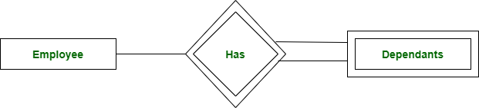
Introduction of E–R Model
Weak Entity Type and Identifying Relationship:
As discussed before, an entity type has a key attribute which uniquely identifies each entity in the entity set. But there exists some entity type for which key attribute can’t be defined. These are called Weak Entity type.
For example, A company may store the information of dependants (Parents, Children, Spouse) of an Employee. But the dependents don’t have existence without the employee. So Dependent will be weak entity type and Employee will be Identifying Entity type for Dependant.
A weak entity type is represented by a double rectangle. The participation of weak entity type is always total. The relationship between weak entity type and its identifying strong entity type is called identifying relationship and it is represented by double diamond.

Slide 57
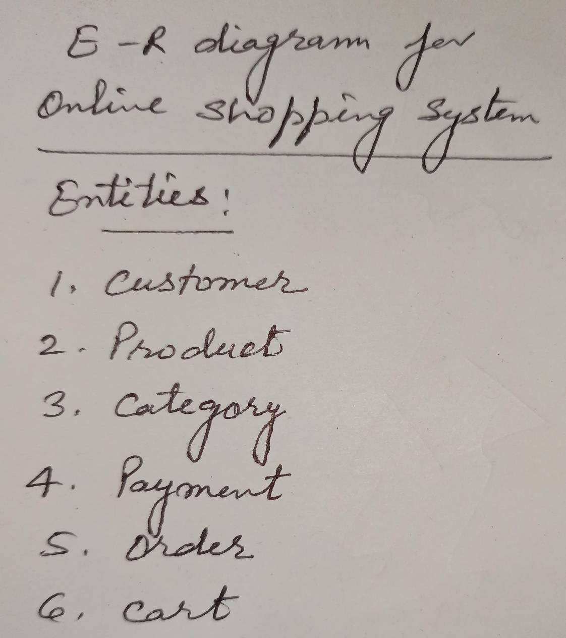
E–R Diagram for Online Shopping System

Slide 58
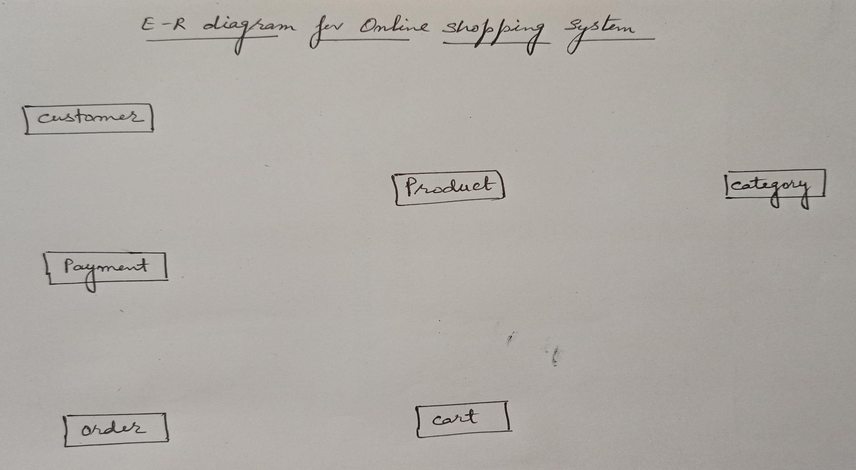
E–R Diagram for Online Shopping System

Slide 59
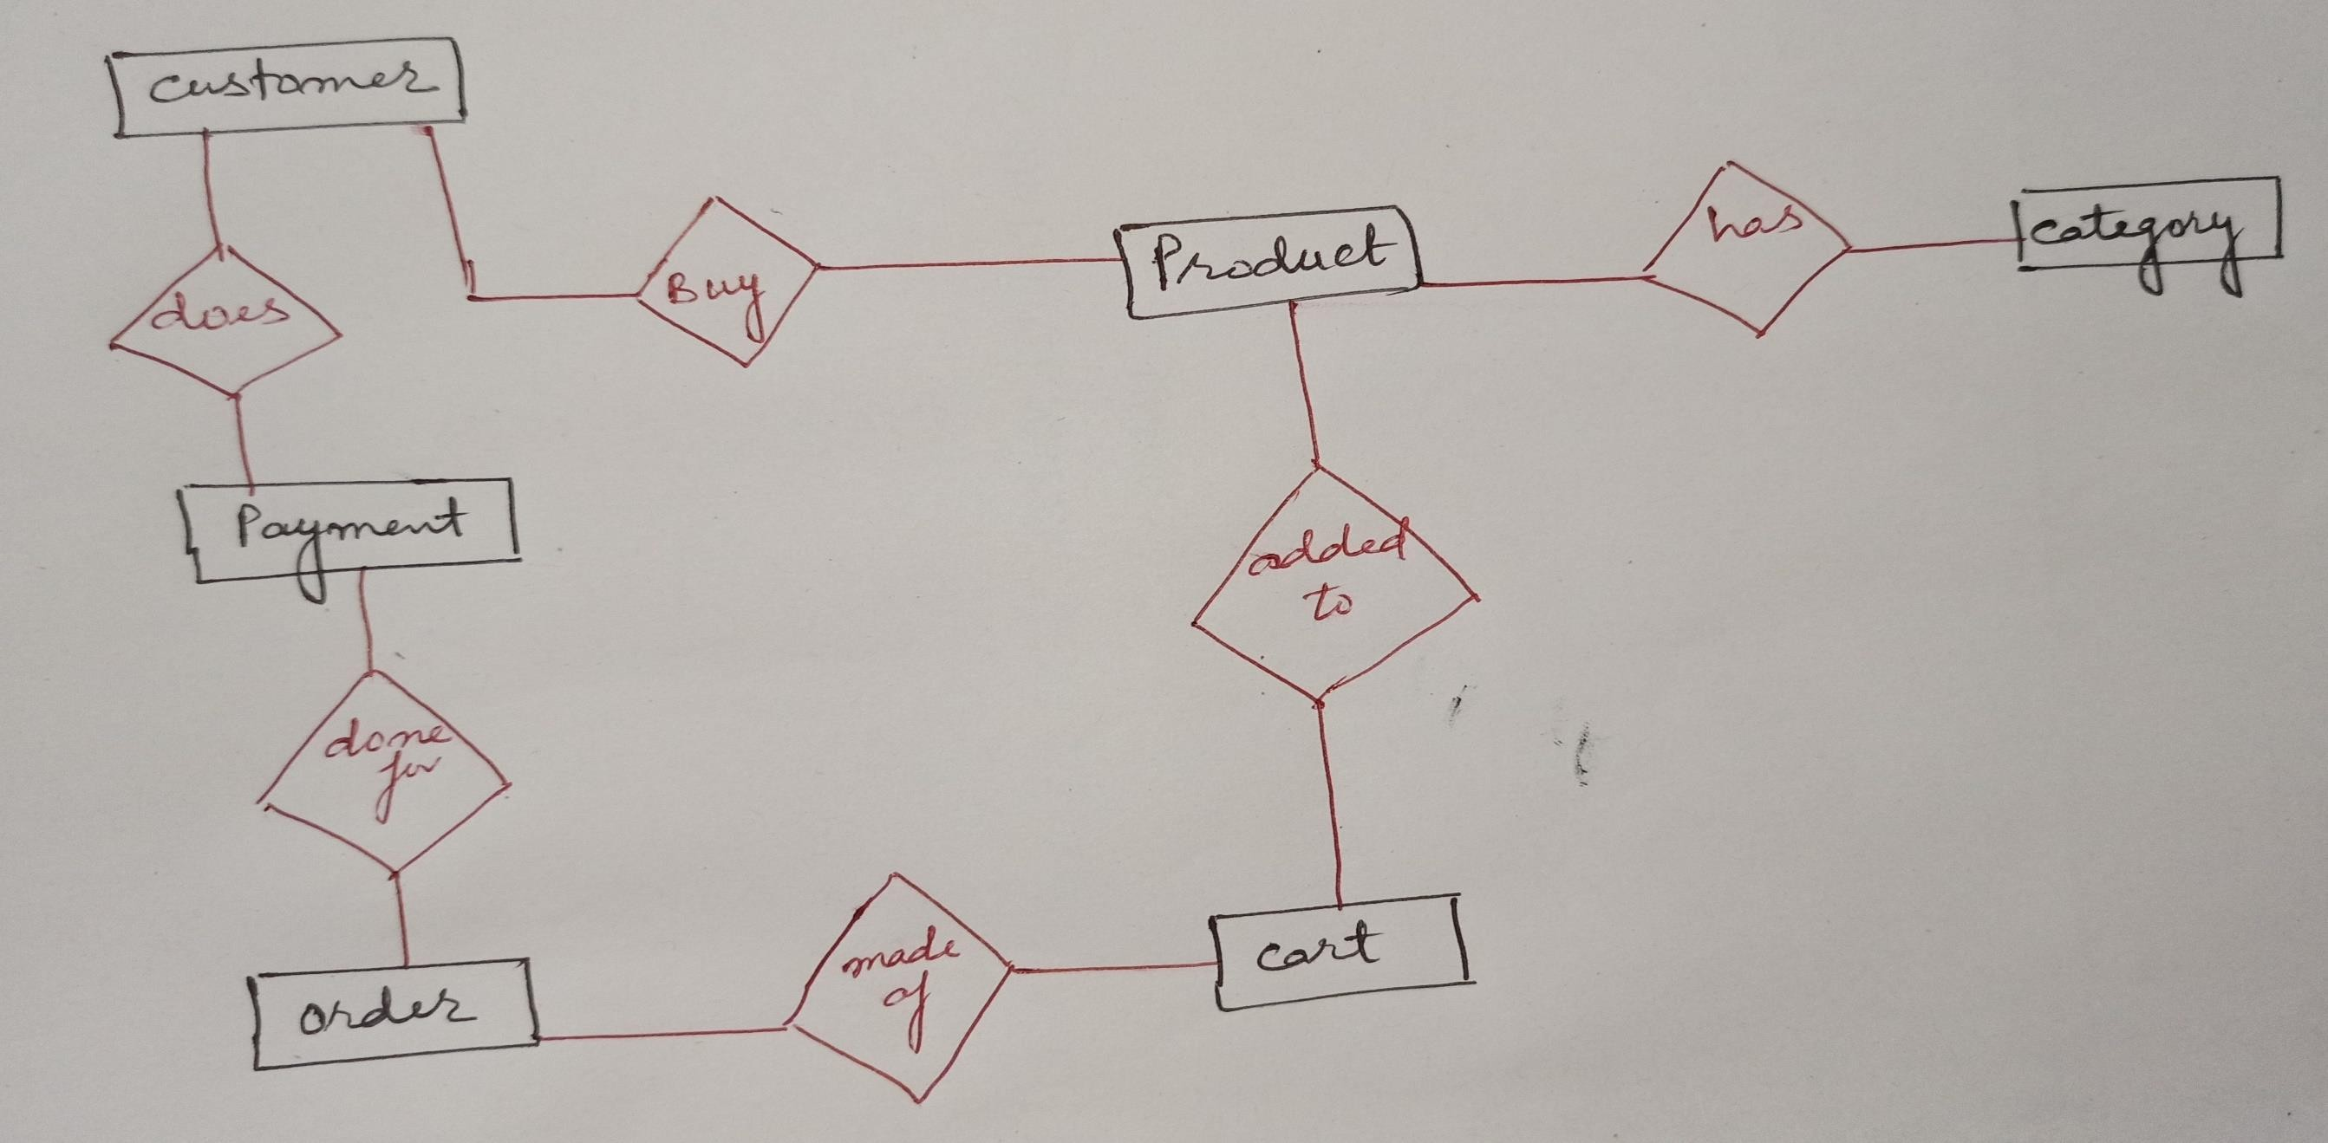
E–R Diagram for Online Shopping System

Slide 60
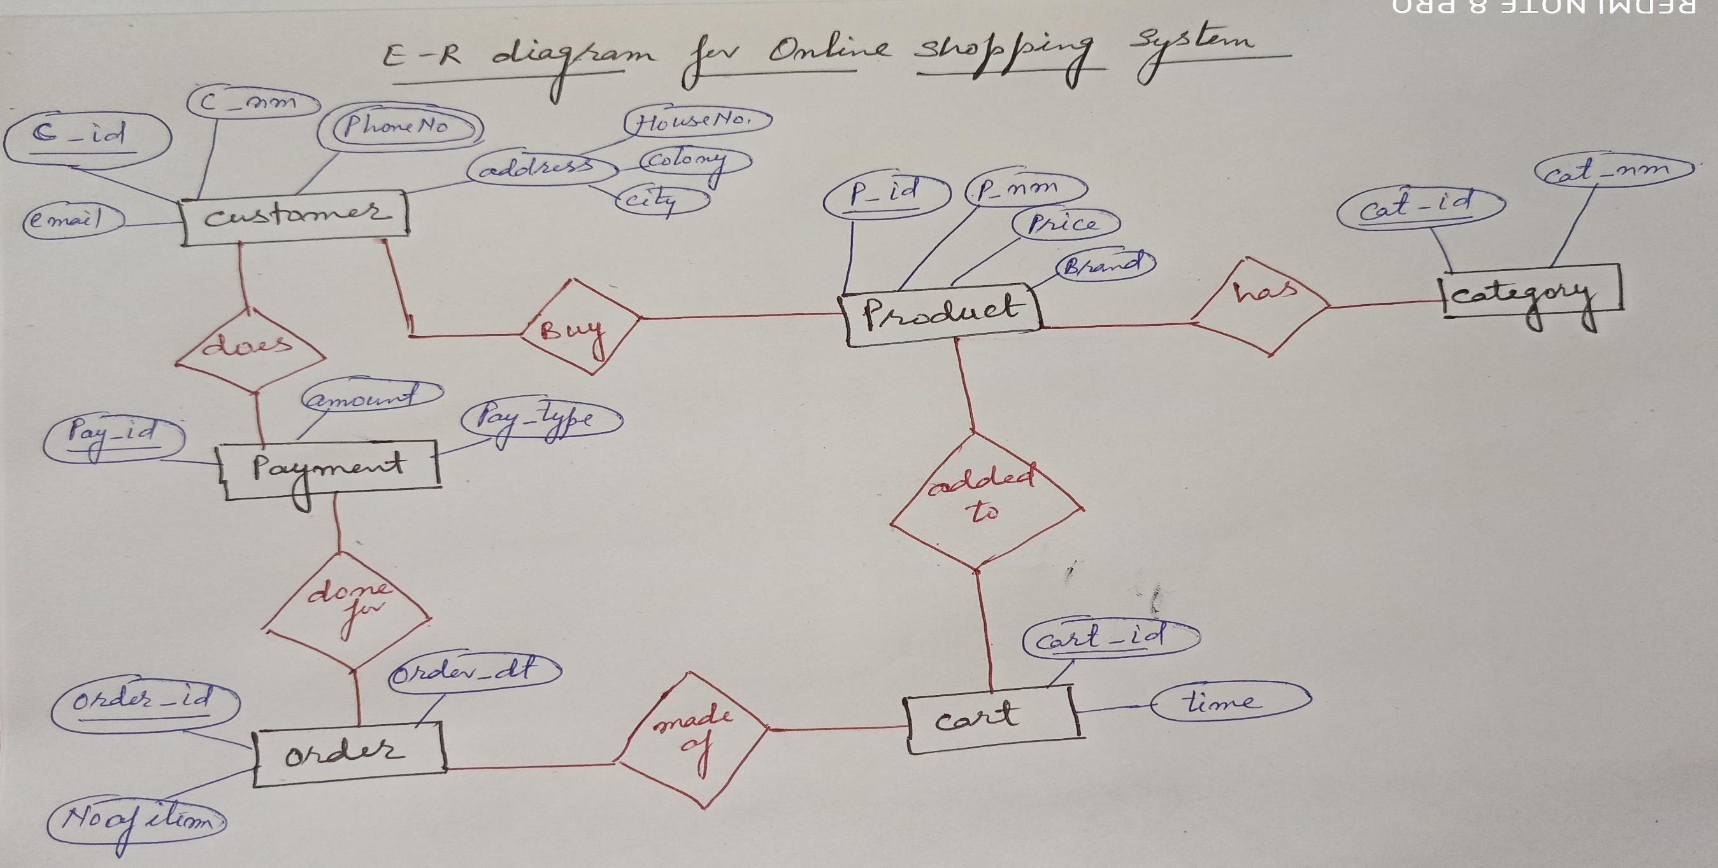
E–R Diagram for Online Shopping System

Slide 61
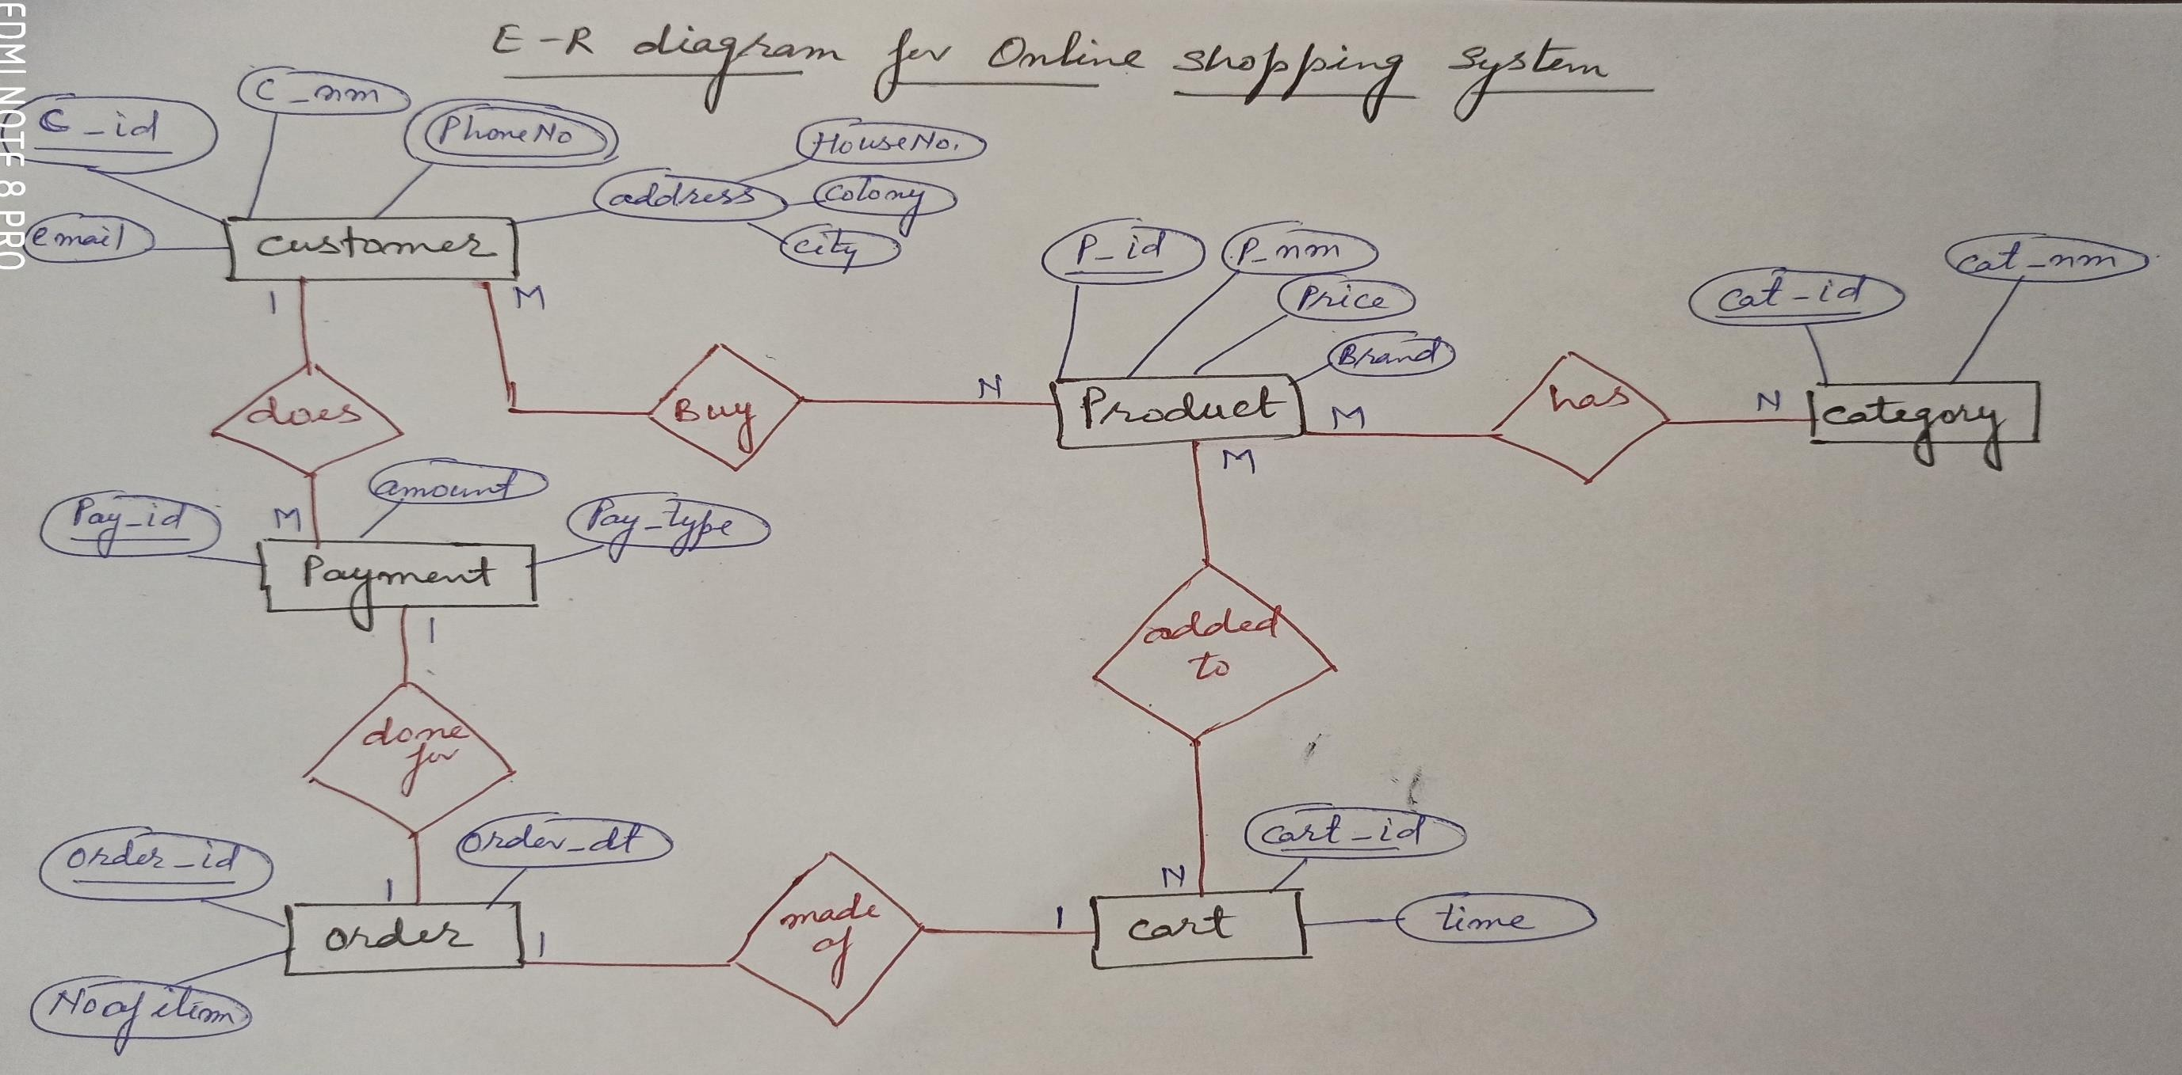
E–R Diagram for Online Shopping System

Slide 62
References
Korth, Silbertz and Sudarshan (1998), “Database Concepts”, 4th Edition, TMH.
Elmasri and Navathe (2010), “Fundamentals of Database Systems”, 5th Edition, Addision Wesley.
Date C J,” An Introduction to Database Systems”, 8th Edition, Addision Wesley.
M. Tamer Oezsu, Patrick Valduriez (2011). “Principles of Distributed Database Systems”, 2nd Edition, Prentice Hall.

Slide 64
Database Management Systems (BCSC-1003)
Topic: EER Diagrams
Dr. Nikhil Govil
Assistant Professor, Dept. of CEA, GLA University, Mathura.

Slide 65
EER Diagram
EER diagram stands for Enhanced (or Extended) Entity Relationship Diagram.
EER is a high-level data model that incorporates the extensions to the original ER model.
Enhanced or Extended ER Diagrams are high level models that represent the requirements and complexities of complex database.
In addition to ER model concepts EER includes Specialization, Generalization and Aggregation.

Slide 66
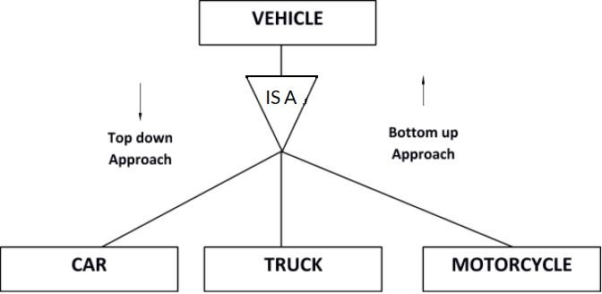
Generalization & Specialization
Generalization: Generalization is a process of generalizing an entity which contains generalized attributes or properties of generalized entities. It is a Bottom up process i.e. consider we have 3 sub entities Car, Truck and Motorcycle. Now these three entities can be generalized into one super class named as Vehicle.
Specialization: Specialization is a process of identifying subsets of an entity that share some different characteristic. It is a top down approach in which one entity is broken down into low level entity.

Slide 67
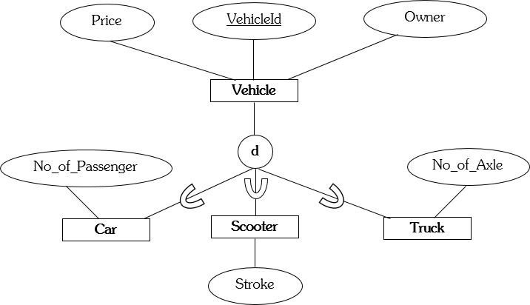
Generalization & Specialization

Slide 68
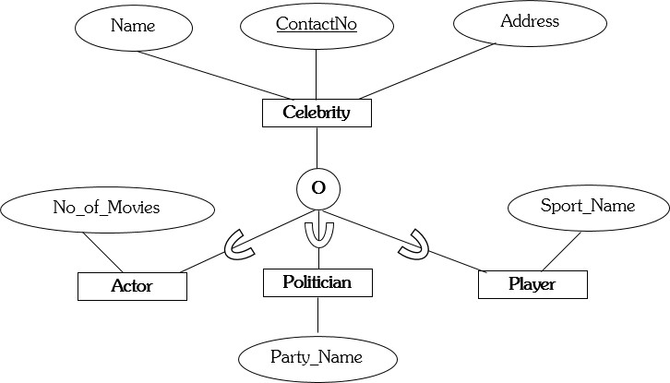
Generalization & Specialization

Slide 69
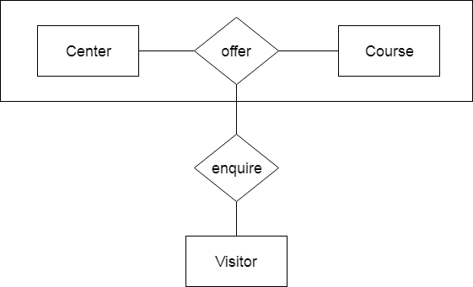
Aggregation
In aggregation, the relation between two entities is treated as a single entity. In aggregation, relationship with its corresponding entities is aggregated into a higher level entity.
Example:
Center entity offers the Course entity act as a single entity in the relationship which is in a relationship with another entity visitor. In the real world, if a visitor visits a coaching center then he will never enquiry about the Course only or just about the Center instead he will ask the enquiry about both.

Slide 70
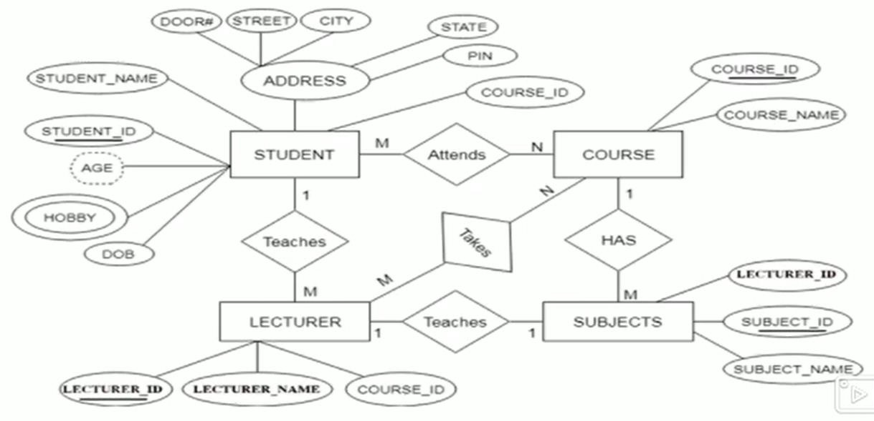
Converting E-R Diagrams into Table

Slide 71
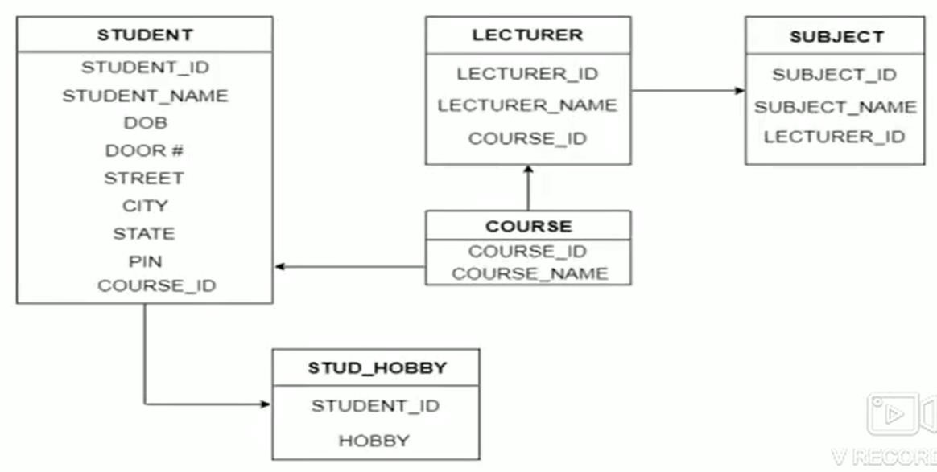
Converting E-R Diagrams into Table

Slide 72
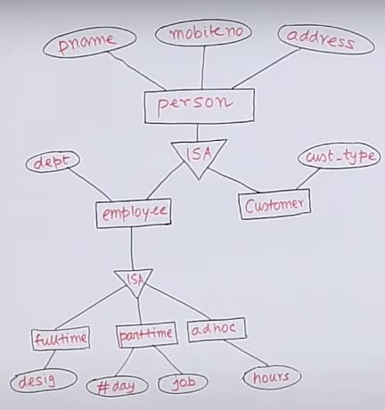
Converting EER Diagrams into Table

Slide 73
Converting EER Diagrams into Table
Tables will be:
CUSTOMER (pname, mobileno, address, cust_type)
FULLTIME (pname, mobileno, address, dept, desig)
PARTTIME (pname, mobileno, address, dept, #days, job)
ADHOC (pname, mobileno, address, dept, hours)

Slide 74
References
Korth, Silbertz and Sudarshan (1998), “Database Concepts”, 4th Edition, TMH.
Elmasri and Navathe (2010), “Fundamentals of Database Systems”, 5th Edition, Addision Wesley.
Date C J,” An Introduction to Database Systems”, 8th Edition, Addision Wesley.
M. Tamer Oezsu, Patrick Valduriez (2011). “Principles of Distributed Database Systems”, 2nd Edition, Prentice Hall.
https://www.javatpoint.com/dbms-aggregation/last accessed on 12 December’ 2022.

Slide 76
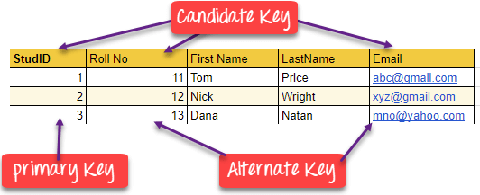
Database Management Systems (BCSC-0003)
Topic: DBMS Keys
Nikhil Govil
Assistant Professor, Dept. of CEA, GLA University, Mathura.

Slide 77
What are the Keys in DBMS?
A key in DBMS is an attribute or a set of attributes that help to uniquely identify a tuple (or row) in a relation (or table).
Keys are also used to establish relationships between the different tables and columns of a relational database. Individual values in a key are called key values.

Slide 78
Why are the Keys Required?
A key is used in the definitions of various kinds of integrity constraints.
A table in a database represents a collection of records or events for a particular relation.
Now there can be thousands and thousands of such records, some of which may be duplicated.
There should be a way to identify each record separately and uniquely,
i.e. no duplicates.
Keys allow us to be free from this hassle.
A key could either be a combination of more than one attribute (or columns) or just a single attribute.
The main motive of this is to give each record a unique identity.

Slide 79
Types of Keys in DBMS
There are broadly nine types of keys in DBMS:
Primary Key
Candidate Key or Secondary Key
Alternate Key
Super Key
Composite Key
Unique Key
Surrogate Key or Artificial Key
Foreign Key
Partial Key

Slide 80
1. Primary Key (PK)
A Primary Key is a column of a table or a set of columns that helps to identify every record present in that table uniquely.
There can be only one Primary Key in a table.
Also, the Primary Key cannot have the same values repeating for any row.
Every value of the Primary Key has to be different with no repetitions.
The Primary Key constraint put on a column or set of columns will not allow them to have any null values or any duplicates.

Slide 81
2. Candidate Key (CK) or Secondary Key
Candidate Keys are those attributes that uniquely identify rows of a table.
The PK of a table is selected from one of the Candidate Keys.
So, Candidate Keys have the same properties as the PK.
There can be more than one Candidate Keys in a table.

Slide 82
3. Alternate Key
A table can have multiple choices for a PK; however, it can choose only one.
So, all the keys which did not become the Primary Key are called Alternate Keys.

Slide 83
4. Super Key (SK)
Super Key is the set of all the keys which help to identify rows in a table uniquely.
This means that all those columns of a table than capable of identifying the other columns of that table uniquely will all be considered super keys.
Super Key is the superset of a Candidate Key.
The Primary Key of a table is picked from the Super Key set to be made the table’s identity attribute.

Slide 84
5. Composite Key
Composite Key is a set of two or more attributes that help identify each tuple in a table uniquely.
The attributes in the set may not be unique when considered separately.
However, when taken all together, they will ensure uniqueness.

Slide 85
6. Unique Key
Unique Key is a column or set of columns that uniquely identify each record in a table.
All values will have to be unique in this key.
A Unique Key differs from a PK because it can have only one null value, whereas a PK cannot have any null values.

Slide 86
7. Surrogate Key or Artificial Key
Surrogate Keys is an Artificial Key which aims to uniquely identify each record is called a Surrogate Key.
This kind of key in DBMS is unique because it is created when we don’t have any natural PK.
They do not lend any meaning to the data in the table.
Surrogate Key in DBMS is usually an integer.
Surrogate keys in SQL are allowed when:
No property has the parameter of the Primary Key.
In the table when the Primary Key is too big or complicated.

Slide 87
8. Foreign Key (FK)
Foreign Key is used to establish relationships between two tables.
A Foreign Key will require each value in a column or set of columns to match the Primary Key of the referential table.
Foreign keys help to maintain data and referential integrity.

Slide 88
9. Partial Key
The set of attributes that are used to uniquely identify a weak entity set is called the Partial key.
Only a bunch of the tuples can be identified using the partial keys.
The Partial Key of the weak entity set is also known as a discriminator.

Slide 89
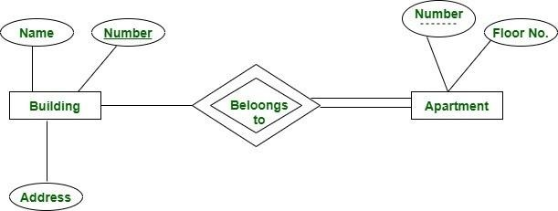
9. Partial Key (Contd …)
Here we have an apartment as a weak entity and building as a strong entity type connected via ‘belongs to’ relationship set. Apartment number is not globally unique i.e. more than one apartment may have same number globally but it is unique for a particular building since a building may not have same apartment number. Thus apartment number cannot be primary key of entity Apartment but it is a partial key shown with a dashed line.

Slide 90
References
Korth, Silbertz and Sudarshan (1998), “Database Concepts”, 4th Edition, TMH.
Elmasri and Navathe (2010), “Fundamentals of Database Systems”, 5th Edition, Addision Wesley.
Date C J,” An Introduction to Database Systems”, 8th Edition, Addision Wesley.
M. Tamer Oezsu, Patrick Valduriez (2011). “Principles of Distributed Database Systems”, 2nd Edition, Prentice Hall.

Slide 92
Database Management Systems (BCSC-1003)
Topic: Relational Algebra in DBMS
Dr. Nikhil Govil
Assistant Professor, Dept. of CEA, GLA University, Mathura.

Slide 93
Relational Algebra
Relational algebra is a widely used procedural query language.
It takes instances of relations as input and yields instances of relations as output.
It uses various operations to perform this action.
Relational algebra mainly provides theoretical foundation for relational databases and SQL.

Slide 94
Basic SQL Relational Algebra Operations
Relational Algebra may be divided in various groups:
Relational Algebra Operations From Set Theory
UNION (∪)
INTERSECTION (∩)
DIFFERENCE (–)

Slide 95
Basic SQL Relational Algebra Operations
Unary Relational Operations
SELECT (σ)
PROJECT (π)
RENAME (ρ)

Slide 96
Basic SQL Relational Algebra Operations
Binary Relational Operations
JOIN (⋈)
Types of JOIN:
Various forms of join operation are:
Cross Join or Cartesian Product
Inner Joins:
(i). Theta join (ii). EQUI join
(iii). Natural join
C. Outer join:
(i). Left Outer Join
(iii). Full Outer Join
(ii). Right Outer Join
II. DIVISION (÷)

Slide 97
Relational Algebra Operations From Set Theory
UNION (∪)
UNION is symbolized by ∪ symbol. It includes all tuples that are in tables A or in B. It also eliminates duplicate tuples. So, set A UNION set B would be expressed as:
R = A ∪ B

Slide 98
Relational Algebra Operations From Set Theory
UNION (∪)
Exp.
Relation A Relation B
CNAME | CSTATUS
RAJAT | GOOD
RAHUL | EXCELLENT
CNAME | CSTATUS
KARAN | POOR
RAJAT | GOOD
CNAME | CSTATUS
RAJAT | GOOD
RAHUL | EXCELLENT
KARAN | POOR
R = A ∪ B

Slide 99
Relational Algebra Operations From Set Theory
INTERSECTION (∩)
INTERSECTION is symbolized by ∩ symbol. Defines a relation consisting of a set of all tuple that are in both A and B. However, A and B must be union-compatible.
R = A ∩ B

Slide 100
Relational Algebra Operations From Set Theory
INTERSECTION (∩)
Exp.
Relation A Relation B
CNAME | CSTATUS
RAJAT | GOOD
RAHUL | EXCELLENT
CNAME | CSTATUS
KARAN | POOR
RAJAT | GOOD
R = A ∩ B
CNAME | CSTATUS
RAJAT | GOOD

Slide 101
Relational Algebra Operations From Set Theory
DIFFERENCE (–)
DIFFERENCE is symbolized by – symbol. The result of A–B, is a relation which includes all tuples that are in A but not in B.
R = A – B

Slide 102
Relational Algebra Operations From Set Theory
DIFFERENCE (–)
Exp.
Relation A Relation B
CNAME | CSTATUS
RAJAT | GOOD
RAHUL | EXCELLENT
CNAME | CSTATUS
KARAN | POOR
RAJAT | GOOD
R = A – B
CNAME | CSTATUS
RAHUL | EXCELLENT

Slide 103
Unary Relational Operations
SELECT (σ)
PROJECT (π)
RENAME (ρ)

Slide 104
SELECT Operator (σ)
SELECT operation is used for selecting a subset of the tuples according to a given selection condition.
Select Operator is denoted by sigma (σ).
It is used as an expression to choose tuples which meet the selection condition.
Select operator selects tuples that satisfy a given predicate.

Slide 105
SELECT Operator (σ)
Syntax:
σ _{<Condition>} (Relation/Table name)
Properties:
It is like a WHERE clause in SQL.
Selection operator is commutative i.e.,
^{σ} <condition_1> ^{( (σ} <condition_2> ^{(R)) = σ} <condition_2> ^{( (σ} <condition_1> ^{(R))}

Slide 106
SELECT Operator (σ)
Examples: STUDENT
ROLL_NO | NAME | AGE | COURSE
1 | ABHISHEK | 17 | BTech
2 | AMIT | 16 | BCA
3 | AJEET | 17 | BTech
4 | AKHIL | 18 | BTech
5 | PRASHANT | 17 | BCA
Query 1: Find out the students of course ‘BTech’.
Syntax:
^{σ} course = ‘BTech’ ^{(student)}
Query2: Find the student(s) whose age is greater than 17. Syntax: σ _{age > 17} (student)

Slide 107
PROJECT or PROJECTION Operator (π)
PROJECT Operator is denoted by pi (π).
Project operation selects certain attributes other attributes.
discarding
It is also known as vertical partitioning since it partitions the relation or table vertically.
Duplicate rows are automatically eliminated, as relation is a set.

Slide 108
PROJECT Operator (π)
Syntax:
π _{<Attribute list>} (Relation/Table name)
Properties:
The degree of output relation (number of columns present) is equal to the number of attributes mentioned in the attribute list.
Projection operator does not obey commutative property i.e.
^{π} <list2> ^{(π} <list1> ^{(R)) ≠ π} <list1> ^{(π} <list2> ^{(R))}

Slide 109
PROJECT Operator (π)
Examples: STUDENT
ROLL_NO | NAME | AGE | COURSE
1 | ABHISHEK | 17 | BTech
2 | AMIT | 16 | BCA
3 | AJEET | 17 | BTech
4 | AKHIL | 18 | BTech
5 | PRASHANT | 17 | BCA
Query 1: Find out the name and course from STUDENT relation.
Syntax:
^{π} name, course ^{(student)}
Query 2: Find the age from STUDENT relation.
AGE
17
16
18
Syntax: π
(student)
age

Slide 110
RENAME Operator (ρ)
The results of relational algebra are also relations but without any name.
The RENAME operation allows us to rename the relation.
It is denoted by rho (ρ).

Slide 111
RENAME Operator (ρ)
Syntax:
ρ (Relation2, Relation1)
Examples:
Query 1: Rename STUDENT relation to STUDENT1 relation. Syntax: ρ (STUDENT1, STUDENT)
Query 2: Create a relation STUDENT_NAMES with RNO and NAME from STUDENT.
Syntax: ρ (STUDENT_NAMES, π _{(RNO, NAME)} (STUDENT))

Slide 112
Binary Relational Algebra Operations
Binary Relational Operations
JOIN (⋈)
Types of JOIN:
Various forms of join operation are:
Cross Join or Cartesian Product
Inner Joins:
(i). Theta join (ii). EQUI join
(iii). Natural join
C. Outer join:
(i). Left Outer Join
(iii). Full Outer Join
(ii). Right Outer Join
II. DIVISION (÷)

Slide 113
Join (⋈)
Join is a binary operation which allows us to combine join product and selection in one single statement.
The goal of creating a join condition is that it helps us to combine the data from two or more DBMS tables.
Various forms of join operation are: Cross Join, Inner Join & Outer Join.

Slide 114
Cross Join or Cartesian Product (×)
Cross Join or Cartesian Product is symbolized by × symbol. It is an operation used to merge columns from two relations. It is also called Cross Product.
R = A × B

Slide 115
Cross Join or Cartesian Product (×)
Exp.
Relation A
Relation B
NAME | AGE
KAJAL | 32
ANIL | 40
JOB | LOCATION
DEVELOPER | CHENNAI
ANALYST | MUMBAI
NAME | AGE | JOB | LOCATION
KAJAL | 32 | DEVELOPER | CHENNAI
KAJAL | 32 | ANALYST | MUMBAI
ANIL | 40 | DEVELOPER | CHENNAI
ANIL | 40 | ANALYST | MUMBAI
R = A × B

Slide 116
Inner Join
INNER JOIN is used to return rows from both tables which satisfy the given condition.
It is the most widely used join operation considered as a default join-type.
Inner Join further divided into three subtypes:
and can be
(i). Theta join (ii). EQUI join (iii). Natural join

Slide 117
Inner Join: Theta Join
THETA JOIN allows us to merge two tables based on the condition represented by theta.
Theta joins work for all comparison operators.
It is denoted by symbol θ.
The general case of JOIN operation is called a Theta join.
Syntax: A ⋈_{θ} B
R1 and R2 are relations having attributes (A₁, A₂, .., A_{n}) and (B₁, B₂, ..., B_{n}) such that the attributes don’t have anything in common, that is R1 ∩ R2 = Φ.

Slide 118
Inner Join: Theta Join
Example: STUDENT
SUBJECT
SID | NAME | STD
1001 | AJAY | 11
1002 | JATIN | 12
CLASS | SUBJECT
11 | MATH
11 | HINDI
12 | COMPUTER
12 | SCIENCE
^{STUDENT ⋈}Student.Std = Subject.Class ^{SUBJECT}
Output:
SID | NAME | STD | CLASS | SUBJECT
1001 | AJAY | 11 | 11 | MATH
1001 | AJAY | 11 | 11 | HINDI
1002 | JATIN | 12 | 12 | COMPUTER
1002 | JATIN | 12 | 12 | SCIENCE

Slide 119
Inner Join: Equi Join
EQUI JOIN is done when a Theta join uses only the equivalence condition.
When Theta join uses only equality comparison operator, it is said to be equi join.
The previous example corresponds to equi join.

Slide 120
Inner Join: Natural Join
NATURAL JOIN does not utilize any of the comparison operators.
In this type of join, the attributes should have the same name and domain.
In Natural Join, there should be at least one common attribute between two relations.
It performs selection forming equality on those attributes which appear in both relations and eliminates the duplicate attributes.

Slide 121
Inner Join: Natural Join
Example: R1
R2
NUM | SQUARE
2 | 4
3 | 9
NUM | CUBE
2 | 8
3 | 27
R1 ⋈ R2
Output:
NUM | SQUARE | CUBE
2 | 4 | 8
3 | 9 | 27

Slide 122
Outer Join
An OUTER JOIN doesn't require each record in the two join tables to have a matching record.
In this type of join, the table retains each record even if no other matching record exists.
Outer Join further divided into three subtypes:
Left Outer Join
Right Outer Join
Full Outer Join

Slide 123
Outer Join: Left Outer Join (𝔴)
LEFT OUTER JOIN returns all the rows from the table on the left even if no matching rows have been found in the table on the right.
When no matching record found in the table on the right, NULL is returned.
It is denoted by symbol (𝔴).
Syntax: A 𝔴 B

Slide 124
Outer Join: Left Outer Join (𝔴)
Example: R1
R2
NUM | SQUARE
2 | 4
3 | 9
4 | 16
NUM | CUBE
2 | 8
3 | 27
5 | 125
R1 𝔴 R2
Output:
NUM | SQUARE | CUBE
2 | 4 | 8
3 | 9 | 27
4 | 16 | NULL

Slide 125
Outer Join: Right Outer Join (⟖)
RIGHT OUTER JOIN returns all the columns from the table on the right even if no matching rows have been found in the table on the left.
Where no matches have been found in the table on the left, NULL is returned. RIGHT OUTER JOIN is the opposite of LEFT OUTER JOIN.
It is denoted by symbol (⟖).
Syntax: A ⟖ B

Slide 126
Outer Join: Right Outer Join (⟖)
Example: R1
R2
NUM | SQUARE
2 | 4
3 | 9
4 | 16
NUM | CUBE
2 | 8
3 | 27
5 | 125
R1 ⟖ R2
Output:
NUM | CUBE | SQUARE
2 | 8 | 4
3 | 27 | 9
5 | 125 | NULL

Slide 127
Outer Join: Full Outer Join (𝔴)
In a FULL OUTER JOIN , all tuples from both relations are included in the result, irrespective of the matching condition.
It is denoted by symbol (𝔴).
Syntax: A 𝔴 B

Slide 128
Outer Join: Full Outer Join (𝔴)
Example: R1
R2
NUM | SQUARE
2 | 4
3 | 9
4 | 16
NUM | CUBE
2 | 8
3 | 27
5 | 125
R1 𝔴 R2
Output:
NUM | SQUARE | CUBE
2 | 4 | 8
3 | 9 | 27
4 | 16 | NULL
5 | NULL | 125

Slide 129
DIVISION (÷)
Division operator A÷B can be applied if and only if:
Attributes of B is proper subset of Attributes of A.
The relation returned by division operator will have attributes
= (All attributes of A – All Attributes of B).
The relation returned by division operator will return those tuples from relation A which are associated to every B’s tuple.
Syntax: A ÷ B

Slide 130
DIVISION (÷)
Relation B has 3 tables as:
Example:
Relation A has 1 table as:
Pno
Pno
P2
P4
Pno
P1
P2
P3
P4
P5
P6
P1
Sno | Pno
S1 | P1
S1 | P2
S1 | P3
S1 | P4
S1 | P5
S1 | P6
S2 | P1
S2 | P2
S3 | P2
S4 | P2
S4 | P4
S4 | P5
Then, A DIVIDE BY B gives the
following resultant tables for all the three cases as follows:
Sno
S1
S2
Sno
S1
S4
Sno
S1

Slide 131
Exercise
Example 1: Consider the following schema: SUPPLIER (Sid, S_name, S_addr)
PARTS (Pid, P_name, color) CATALOG (sid, pid, cost)
Now, answer the following queries in Relational Algebra:
Find the name of all the suppliers who supply Yellow parts.
Find the Sid of suppliers who supply every parts.
Find the Sid of suppliers who supply every red or green part.

Slide 132
Exercise
Solution:
Find the name of all the suppliers who supply Yellow parts.
π _{S_name} (SUPPLIER) ⋈ CATALOG ⋈ (σ _{color = ‘Yellow’} (PARTS))
Find the Sid of suppliers who supply every parts.
π_{sid, pid} (CATALOG) ÷ π _{pid} (PARTS)
Find the Sid of suppliers who supply every red or green part.
^{(π}sid, pid ^{(CATALOG)) ÷ (π} pid ^{(σ} color = ‘red’ ∨ color = ‘green’ ^{(PARTS)))}

Slide 133
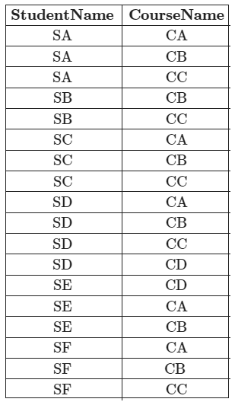
Exercise
Example 2: Consider a database that has the relation schema CR (StudentName, CourseName). An instance of the schema CR is as given below.
The following queries are made on the database.
^{T1← π}CourseName^{(σ}StudentName=‘SA’^{(CR))} T2← CR ÷ T1
The number of rows in T2 are .
(GATE 2017)

Slide 134
Exercise
Solution:
T1 will give:
CourseName
CA
CB
CC
T2←CR÷T1 = All the tuples in CR which are matched with every tuple in T1:
StudentName
SA
SC
SD
SF

Slide 135
Reference Books
Elmasri and Navathe (2010), “Fudamentals of Database Systems”, 5th Edition, Addision Wesley.
Date C J,” An Introduction to Database Systems”, 8th Edition, Addision Wesley.
Korth, Silbertz and Sudarshan (1998), “Database Concepts”, 4th Edition, TMH.
M. Tamer Oezsu, Patrick Valduriez (2011). “Principles of Distributed Database Systems”, 2nd Edition, Prentice Hall.

Slide 136
Thank You !!!

Slide 137
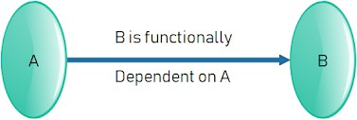
Database Management Systems (BCSC – 1003)
Topic: Functional Dependency
Dr. Nikhil Govil
Assistant Professor, Dept. of CEA, GLA University, Mathura.

Slide 138
Functional Dependency
The functional dependency is a relationship that exists between two attributes.
It typically exists between the primary key and non-key attribute within a table.
It is usually denoted as: X → Y
The left side of arrow is known as a determinant, the right side of the arrow is known as a dependent.

Slide 139
Functional Dependency
Example:
Assume, we have an EMPLOYEE table with attributes: Emp_Id, Emp_Name, Emp_Address.
Here Emp_Id attribute can uniquely identify the Emp_Name attribute of employee table because if we know the Emp_Id, we can tell that employee name associated with it. Functional dependency can be written as:
Emp_Id → Emp_Name
We can say that Emp_Name is functionally dependent on Emp_Id.

Slide 140
Functional Dependency
Types of Functional Dependencies:
Trivial functional dependency
Non-trivial functional dependency
Multivalued dependency
Transitive dependency

Slide 141
Functional Dependency
1. Trivial functional dependency
A → B has trivial functional dependency if B is a subset of A. The following dependencies are also trivial like: A → A, B → B
Example:
Consider a table with two columns Employee_Id and Employee_Name.
{Employee_id, Employee_Name} → Employee_Id is a trivial functional dependency as Employee_Id is a subset of {Employee_Id, Employee_Name}.
Also, Employee_Id → Employee_Id and
Employee_Name → Employee_Name are trivial dependencies too.

Slide 142
Functional Dependency
2. Non-trivial functional dependency
A → B has a non-trivial functional dependency if B is not a subset of A.
When A intersection B is NULL, then A → B is called as complete non- trivial.
Example:
ID → Name, Name → DOB

Slide 143
Functional Dependency
3. Multivalued functional dependency
When existence of one or more rows in a table implies one or more other rows in the same table, then the Multi-valued dependencies occur.
If a table has attributes P, Q and R, then Q and R are multi-valued facts of P. It is represented by double arrow as → →
Example 1:
P → → Q P → → R
In this case, Multivalued Dependency exists only if Q and R are independent attributes.

Slide 144
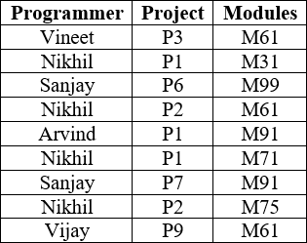
Functional Dependency
Example: Consider following table Prog_Proj below showing Multivalued dependency. PROG_ PROJ
Here columns PROJECT & MODULES are independent of each other and dependent on PROGRAMMER. In this case these two columns are said to be multivalued dependent on PROGRAMMER. These dependencies can be represented like this:
PROGRAMMER → → PROJECT and PROGRAMMER → → MODULES

Slide 145
Functional Dependency
4. Transitive functional dependency
A functional dependency is said to be transitive if it is indirectly formed by two functional dependencies.
Example:
X → Z is a transitive dependency if the following functional dependencies hold true:
X → Y
Y → Z
A transitive dependency can only occur in a relation of three of more attributes. This dependency helps us normalizing the database in 3NF (3rd Normal Form).

Slide 146
References
Korth, Silbertz and Sudarshan (1998), “Database Concepts”, 4th Edition, TMH.
Elmasri and Navathe (2010), “Fundamentals of Database Systems”, 5th Edition, Addision Wesley.
Date C J,” An Introduction to Database Systems”, 8th Edition, Addision Wesley.
M. Tamer Oezsu, Patrick Valduriez (2011). “Principles of Distributed Database Systems”, 2nd Edition, Prentice Hall.

Slide 148
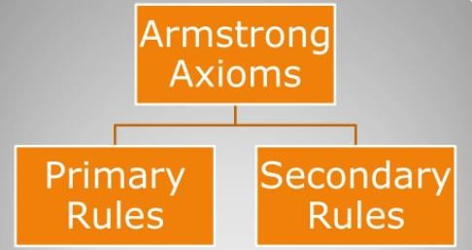
Database Management System (BCSC–1003)
Topic: Armstrong Axioms (Inference Rules)
Dr. Nikhil Govil
Assistant Professor, Dept. of CEA, GLA University, Mathura.

Slide 149
Armstrong Axioms (Inference Rule) in Functional Dependecy in DBMS
Introduction to Axioms Rules:
Armstrong's Axioms is a set of rules.
It provides a simple technique for reasoning about functional dependencies.
William W. Armstrong developed it in 1974.
It is used to infer all the functional dependencies on a relational database.

Slide 150
Armstrong Axioms (Inference Rule)
Armstrong Axioms can be classified as:

Slide 151
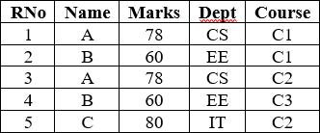
Armstrong Axioms (Inference Rule)
Consider a relation STUDENT

Slide 152
Primary Rules
Rule 1. Reflexivity
{A → A} and,
If A is a set of attributes and B is a subset of A, then A holds B.
{A → B}. This is trivial property.
Example:
RNo → RNo (✓)
(RNo, Name) → Name (✓)

Slide 153
Primary Rules
Rule 2. Augmentation
If A → B holds and Y is attribute set, then AY → BY also holds.
That means adding attributes in dependencies, does not change the basic dependencies.
If A → B, then AC → BC for any C.
Example:
If RNo → Name (✓)
then {RNo, Marks} → {Name, Marks} (✓)

Slide 154
Primary Rules
Rule 3. Transitivity
If A holds B and B holds C, then A holds C.
It means if {A → B} and {B → C}, then {A → C}.
A holds B {A → B} means that A functionally determines B.
Example:
If Name → Marks (✓) and Marks → Dept (✓) then Name → Dept (✓)

Slide 155
Secondary Rules
Rule 1. Union
If {A → B} and {A → C}, then {A → BC} Example:
If RNo → Name (✓) and RNo → Marks (✓)
then RNo → Name, Marks (✓)

Slide 156
Secondary Rules
Rule 2. Decomposition or Splitting property
If {A → BC} then {A → B} and {A → C}
But if AB → C then we can’t split the LHS as A → C and B → C
Example:
If (RNo → Name, Marks) (✓)
Then (RNo → Name) (✓) and (RNo → Marks) (✓)

Slide 157
Secondary Rules
Rule 3. Pseudo Transitivity
If{A → B} and {BC → D}, then {AC → D} Example:
RNo → Name (✓) and (Name, Marks) → Dept (✓)
then (RNo, Marks) → Dept (✓)

Slide 158
Secondary Rules
Rule 4. Composition
If X → Y and A → B then XA → YB Example:
RNo → Name (✓) and Marks → Dept (✓)
then (RNo, Marks) → (Name, Dept) (✓)

Slide 159
Example
Question: Consider relation E = (P, Q, R, S, T, U) having set of following Functional Dependencies (FD).
P → Q | P → R | QR → S
Q → T | QR → U | PR → U
Calculate some members of Axioms are as follows:
P → T
PR → S
QR → SU
PR → SU

Slide 160
Example
Solution:
1. P → T
In the above FD set, P → Q and Q → T
So, Using Transitive Rule: If {A → B} and {B → C}, then {A → C}
∴ If P → Q and Q → T, then P → T. P → T

Slide 161
Example
2. PR → S
In the above FD set, P → Q As, QR → S
So, Using Pseudo Transitivity Rule: If{A → B} and {BC → D}, then {AC → D}
∴ If P → Q and QR → S, then PR → S. PR → S

Slide 162
Example
3. QR → SU
In above FD set, QR → S and QR → U
So, Using Union Rule: If{A → B} and {A → C}, then {A → BC}
∴ If QR → S and QR → U, then QR → SU. QR → SU

Slide 163
Example
4. PR → SU
So, Using Union Rule: If{A → B} and {A → C}, then {A → BC}
∴ If PR → S and PR → U, then PR → SU. PR → SU

Slide 164
References
Korth, Silbertz and Sudarshan (1998), “Database Concepts”, 4th Edition, TMH.
Elmasri and Navathe (2010), “Fundamentals of Database Systems”, 5th Edition, Addision Wesley.
Date C J,” An Introduction to Database Systems”, 8th Edition, Addision Wesley.
M. Tamer Oezsu, Patrick Valduriez (2011). “Principles of Distributed Database Systems”, 2nd Edition, Prentice Hall.

Slide 166
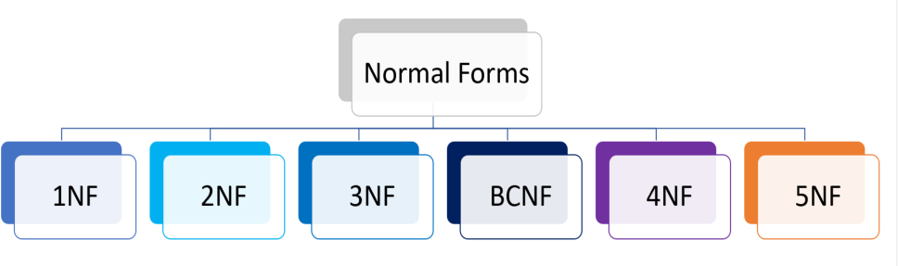
Database Management Systems (BCSC-0003)
Topic: Normalization
Nikhil Govil
Assistant Professor, Dept. of CEA, GLA University, Mathura.

Slide 167
Normalization
Normalization is a database design technique that reduces data redundancy and eliminates undesirable characteristics like Insertion, Update and Deletion Anomalies.
Normalization rules divides larger tables into smaller tables and links them using relationships.
The purpose of Normalization in SQL is to eliminate redundant (repetitive) data and ensure data is stored logically.

Slide 168
Anomalies
Anomalies are problems that can occur in poorly planned, un-normalized databases where all the data is stored in one table.
Types of Anomalies:
Insert Anomaly,
Update Anomaly, and
Delete Anomaly.

Slide 169
Anomalies
Insertion Anomaly:
An Insert Anomaly occurs when certain attributes cannot be inserted into the database without the presence of other attributes.
Update or Modification Anomaly:
An update anomaly is a data inconsistency redundancy and a partial update.
that
results
from
data
Deletion Anomaly:
Deletion Anomaly. A deletion anomaly occurs when you delete a record that may contain attributes that shouldn't be deleted.

Slide 170
Anomalies
SRNO | SNAME | CREDIT | DEPT_NAME | BUILDING | ROOM_NO
1 | Rahul | 5 | CSE | B1 | 101
2 | Jitendra | 8 | CSE | B1 | 101
3 | Jagdish | 9 | EE | B2 | 201
4 | Payal | 7 | EE | B2 | 201
5 | Ankur | 9 | CIVIL | B1 | 110
6 | Akash | 8 | ECE | B1 | 115
7 | Vansh | 7 | CIVIL | B1 | 110
8 | Tanuj | 6 | CSE | B1 | 101

Slide 171
Insert Anomalies
SRNO | SNAME | CREDIT | DEPT_NAME | BUILDING | ROOM_NO
1 | Rahul | 5 | CSE | B1 | 101
2 | Jitendra | 8 | CSE | B1 | 101
3 | Jagdish | 9 | EE | B2 | 201
4 | Payal | 7 | EE | B2 | 201
5 | Ankur | 9 | CIVIL | B1 | 110
6 | Akash | 8 | ECE | B1 | 115
7 | Vansh | 7 | CIVIL | B1 | 110
8 | Tanuj | 6 | CSE | B1 | 101
- | - | - | ME | B1 | 120

Slide 172
Update Anomalies
SRNO | SNAME | CREDIT | DEPT_NAME | BUILDING | ROOM_NO
1 | Rahul | 5 | CSE | B1 B4 | 101 301
2 | Jitendra | 8 | CSE | B1 B4 | 101 301
3 | Jagdish | 9 | EE | B2 | 201
4 | Payal | 7 | EE | B2 | 201
5 | Ankur | 9 | CIVIL | B1 | 110
6 | Akash | 8 | ECE | B3 | 115
7 | Vansh | 7 | CIVIL | B1 | 110
8 | Tanuj | 6 | CSE | B1 B4 | 101 301

Slide 173
Delete Anomalies
SRNO | SNAME | CREDIT | DEPT_NAME | BUILDING | ROOM_NO
1 | Rahul | 5 | CSE | B1 | 101
2 | Jitendra | 8 | CSE | B1 | 101
3 | Jagdish | 9 | EE | B2 | 201
4 | Payal | 7 | EE | B2 | 201
5 | Ankur | 9 | CIVIL | B1 | 110
6 | Akash | 8 | ECE | B1 | 115
7 | Vansh | 7 | CIVIL | B1 | 110
8 | Tanuj | 6 | CSE | B1 | 101

Slide 174
Solution
STUDENT
DEPARTMENT
SRNO | SNAME | CREDIT | DEPT_NA ME
1 | Rahul | 5 | CSE
2 | Jitendra | 8 | CSE
3 | Jagdish | 9 | EE
4 | Payal | 7 | EE
5 | Ankur | 9 | CIVIL
6 | Akash | 8 | ECE
7 | Vansh | 7 | CIVIL
8 | Tanuj | 6 | CSE
DEPT_NA ME | BUILDING | ROOM_NO
CSE | B4 | 301
EE | B2 | 201
CIVIL | B1 | 110
ECE | B1 | 115

Slide 175
Advantages of Normalization
Following are some of the advantages of normalization:
To reduce the redundancy from the table.
To save the memory space as data can be stored in compact form.
To remove Insert, Update and Delete anomalies.
Normalization minimizes the null values.
Using normalization, we can simple the queries.
6. It
is important for OLTP (Online Transaction Processing). However De-
normalization supports OLAP (Online Analytical Processing).
7. It simplifies the database structure.
8. Searching, sorting and creating indexes will be faster after applying the normalization.

Slide 176
References
Korth, Silbertz and Sudarshan (1998), “Database Concepts”, 4th Edition, TMH.
Elmasri and Navathe (2010), “Fundamentals of Database Systems”, 5th Edition, Addision Wesley.
Date C J,” An Introduction to Database Systems”, 8th Edition, Addision Wesley.
M. Tamer Oezsu, Patrick Valduriez (2011). “Principles of Distributed Database Systems”, 2nd Edition, Prentice Hall.

Slide 178
Database Management Systems (BCSC-0003)
Topic: Normalization
Nikhil Govil
Assistant Professor, Dept. of CEA, GLA University, Mathura.

Slide 179
Normalization
Normalization is a database design technique that reduces data redundancy and eliminates undesirable characteristics like Insertion, Update and Deletion Anomalies.
Normalization rules divides larger tables into smaller tables and links them using relationships.
The purpose of Normalization in SQL is to eliminate redundant (repetitive) data and ensure data is stored logically.

Slide 180
Types of Normal Form
Here is a list of Normal Forms
1NF (First Normal Form)
2NF (Second Normal Form)
3NF (Third Normal Form)
BCNF (Boyce-Codd Normal Form)
4NF (Fourth Normal Form)
5NF (Fifth Normal Form)
6NF (Sixth Normal Form)

Slide 181
First Normal Form (1NF)
A relation will be in 1NF if it contains an atomic value.
It states that an attribute of a table cannot hold multiple values. It must hold only single-valued attribute.
First normal form disallows the multi-valued attribute, composite attribute, and their combinations.

Slide 182
First Normal Form (1NF)
Example:
Relation EMPLOYEE is not in 1NF because of multi-valued attribute EMP_PHONE.
EMPLOYEE table:
EMP_ID | EMP_NAME | EMP_PHONE | STATE
2925 | RAJESH | 9500407832, 9088170884 | TAMILNADU
6796 | KISHORE | 9510508668 | KARNATAKA
4592 | ALOK | 8455661732 | PUNJAB
3565 | HEMANT | 9759105522, 9414525254 | GUJRAT

Slide 183
First Normal Form (1NF)
The decomposition of the EMPLOYEE table into 1NF has been shown below:
EMP_ID | EMP_NAME | EMP_PHONE | STATE
2925 | RAJESH | 9500407832 | TAMILNADU
2925 | RAJESH | 9088170884 | TAMILNADU
6796 | KISHORE | 9510508668 | KARNATAKA
4592 | ALOK | 8455661732 | PUNJAB
3565 | HEMANT | 9759105522 | GUJRAT
3565 | HEMANT | 9414525254 | GUJRAT

Slide 184
Second Normal Form (2NF)
In the 2NF, relational must be in 1NF.
In the second normal form, all non-key attributes are fully functional dependent on the primary key.
Example:
Let's assume, a college can store the data of teachers and the subjects they teach. In a college, a teacher can teach more than one subject.
TEACHER table:
TEACHER_ID | SUBJECT | TEACHER_AGE
2529 | Information Technology | 30
2529 | Soft Computing | 30
6535 | Data Communication | 45
3578 | Soft Computing | 35
3578 | Digital Image Processing | 35

Slide 185
Second Normal Form (2NF)
In the given table, non-prime attribute TEACHER_AGE is dependent on TEACHER_ID. That's why it violates the rule for 2NF.
To convert the given table into 2NF, we decompose it into two tables:
TEACHER_DETAIL Table and TEACHER_SUBJECT Table:
TEACHER_ID | TEACHER_AGE
2529 | 30
6535 | 45
3578 | 35
TEACHER_ID | SUBJECT
2529 | Information Technology
2529 | Soft Computing
6535 | Data Communication
3578 | Soft Computing
3578 | Digital Image Processing

Slide 186
Third Normal Form (3NF)
A relation will be in 3NF if it is in 2NF and not contain any transitive partial dependency.
3NF is used to reduce the data duplication. It is also used to achieve the data integrity.
If there is no transitive dependency for non-prime attributes, then the relation must be in third normal form.
A relation is in third normal form if it holds at least one of the following conditions for every non-trivial function dependency X → Y.
X is a super key.
Y is a prime attribute, i.e., each element of Y is part of some candidate key.

Slide 187
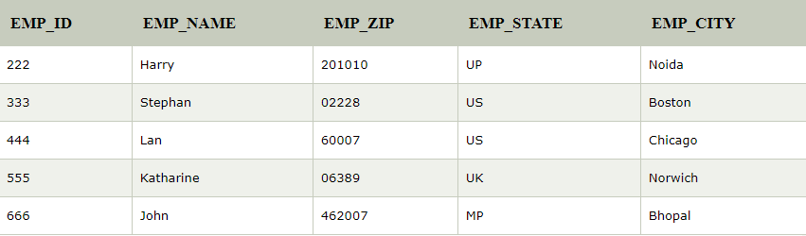
Third Normal Form (3NF)
EMPLOYEE_DETAIL table:
Super key in the table above:
{EMP_ID}, {EMP_ID, EMP_NAME}, {EMP_ID, EMP_NAME, EMP_ZIP}.... so on.
Candidate key: {EMP_ID}
Non-prime attributes: In the given table, all attributes except EMP_ID are non-prime.
Here, EMP_STATE & EMP_CITY dependent on EMP_ZIP and EMP_ZIP dependent on EMP_ID. The non-prime attributes (EMP_STATE, EMP_CITY) transitively dependent on super key (EMP_ID). It violates the rule of third normal form.

Slide 188
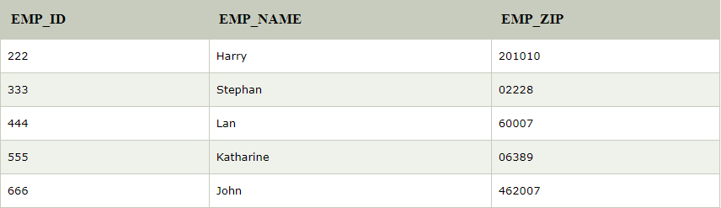
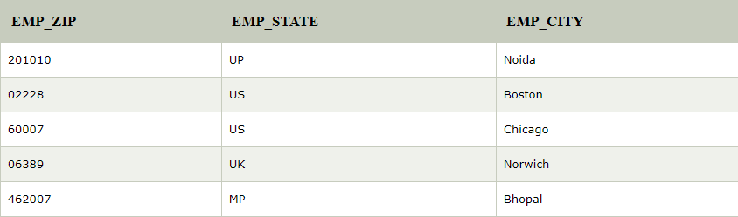
Third Normal Form (3NF)
That's why we need to move the EMP_CITY and EMP_STATE to the new
<EMPLOYEE_ZIP> table, with EMP_ZIP as a Primary key.
EMPLOYEE table:
EMPLOYEE_ZIP Table:

Slide 189
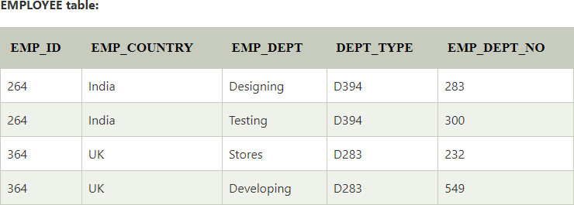
Boyce-Codd Normal Form (BCNF)
BCNF is the advance version of 3NF. It is stricter than 3NF.
A table is in BCNF if every functional dependency X → Y, X is the super key of the table.
For BCNF, the table should be in 3NF, and for every FD, LHS is super key.

Slide 190
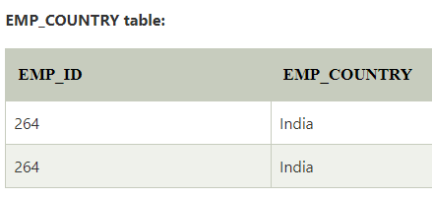
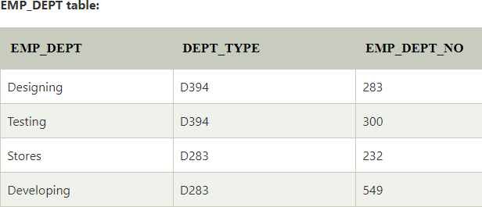
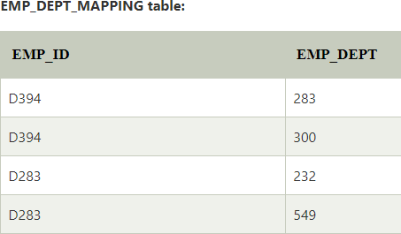
Boyce-Codd Normal Form (BCNF)
In the above table Functional dependencies are as follows:
EMP_ID → EMP_COUNTRY
EMP_DEPT → {DEPT_TYPE, EMP_DEPT_NO}

Slide 191
References
Korth, Silbertz and Sudarshan (1998), “Database Concepts”, 4th Edition, TMH.
Elmasri and Navathe (2010), “Fundamentals of Database Systems”, 5th Edition, Addision Wesley.
Date C J,” An Introduction to Database Systems”, 8th Edition, Addision Wesley.
M. Tamer Oezsu, Patrick Valduriez (2011). “Principles of Distributed Database Systems”, 2nd Edition, Prentice Hall.

Slide 193
Database Management Systems (BCSC-0003)
Topic: Normal Forms: 4NF & 5NF
Nikhil Govil
Assistant Professor, Dept. of CEA, GLA University, Mathura.

Slide 194
Fourth Normal Form (4NF)
A relation will be in 4NF if it is in Boyce–Codd normal form and has no multi-valued dependency.
For a dependency A → B, if for a single value of A, multiple values of B exists, then the relation will be a multi-valued dependency.
Example: STUDENT
STD_ID | COURSE | HOBBY
21 | COMPUTER | DANCING
21 | MATH | SINGING
34 | CHEMISTRY | DANCING
74 | BIOLOGY | CRICKET
59 | PHYSICS | HOCKEY

Slide 195
Fourth Normal Form (4NF)
The given STUDENT table is in 3NF, but the COURSE and HOBBY are two independent entity.
Hence, there is no relationship between COURSE and HOBBY.
In the STUDENT relation, a student with STD_ID, 21 contains two courses, Computer and Math and two hobbies, Dancing and Singing.
So there is a Multi-valued dependency on STD_ID, which leads to unnecessary repetition of data.

Slide 196
Fourth Normal Form (4NF)
So to make the above table into 4NF, we can decompose it into two tables:
Example: STUDENT_COURSE STUDENT_HOBBY
STD_ID | COURSE
21 | COMPUTER
21 | MATH
34 | CHEMISTRY
74 | BIOLOGY
59 | PHYSICS
STD_ID | HOBBY
21 | DANCING
21 | SINGING
34 | DANCING
74 | CRICKET
59 | HOCKEY

Slide 197
Fifth Normal Form (5NF)
A relation is in 5NF if it is in 4NF and not contains any join dependency and joining should be lossless.
5NF is satisfied when all the tables are broken into as many tables as possible in order to avoid redundancy.
5NF is also known as Project-join normal form (PJ/NF). Example: SUBJECT_DETAILS
SUBJECT | LECTURER | SEMESTER
COMPUTER | ANSHIKA | SEMESTER 1
COMPUTER | JOHN | SEMESTER 1
MATH | JOHN | SEMESTER 1
MATH | AKASH | SEMESTER 2
CHEMISTRY | PRAVEEN | SEMESTER 1

Slide 198
Fifth Normal Form (5NF)
In the SUBJECT_DETAILS table, John takes both Computer and Math class for Semester 1 but he doesn't take Math class for Semester
2. In this case, combination of all these fields required to identify a valid data.
Suppose we add a new Semester as Semester 3 but do not know about the subject and who will be taking that subject so we leave Lecturer and Subject as NULL. But all three columns together acts as a primary key, so we can't leave other two columns blank.
So to make the above table into 5NF, we can decompose it into three relations T1, T2 & T3:

Slide 199
Fifth Normal Form (5NF)
T1 table:
SEMESTER | SUBJECT
SEMESTER 1 | COMPUTER
SEMESTER 1 | MATH
SEMESTER 1 | CHEMISTRY
SEMESTER 2 | MATH
T2 table:
SUBJECT | LECTURER
COMPUTER | ANSHIKA
COMPUTER | JOHN
MATH | JOHN
MATH | AKASH
CHEMISTRY | PRAVEEN

Slide 200
Fifth Normal Form (5NF)
T3 table:
SEMESTER | LECTURER
SEMESTER 1 | ANSHIKA
SEMESTER 1 | JOHN
SEMESTER 1 | JOHN
SEMESTER 2 | AKASH
SEMESTER 1 | PRAVEEN

Slide 201
References
Korth, Silbertz and Sudarshan (1998), “Database Concepts”, 4th Edition, TMH.
Elmasri and Navathe (2010), “Fundamentals of Database Systems”, 5th Edition, Addision Wesley.
Date C J,” An Introduction to Database Systems”, 8th Edition, Addision Wesley.
M. Tamer Oezsu, Patrick Valduriez (2011). “Principles of Distributed Database Systems”, 2nd Edition, Prentice Hall.
https://www.javatpoint.com/ last accessed on 07 Feb’2021.

Slide 203
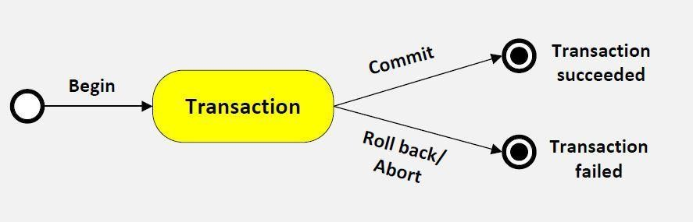
Database Management System (BCSC – 1003)
Topic: Transaction Processing
Dr. Nikhil Govil
Assistant Professor, Dept. of CEA, GLA University, Mathura.

Slide 204
Topics to be covered
Transaction
Operations of Transaction
Transaction Property
State of Transaction

Slide 205
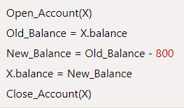
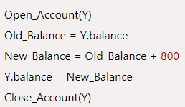
Transaction
The transaction is a set of logically related operation. It contains a group of tasks.
A transaction is an action or series of actions. It is performed usually by a single user to perform operations for accessing the contents of the database.
Example: Suppose an employee of bank transfers Rs 800 from X's account to Y's account. This small transaction contains several low-level tasks:
X’s A/c Y’s A/c

Slide 206
Operations of Transaction
Following are the main operations of transaction:
Read (X): Read operation is used to read the value of X from the database and stores it in a buffer in main memory.
Write (X): Write operation is used to write the value back to the database from the buffer.
Commit: It is used to save the work done permanently.
Rollback: It is used to undo the work done.

Slide 207
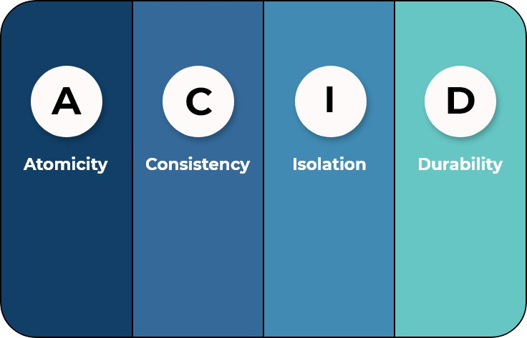
Transaction Property
The transaction has the four properties.
These are used to maintain consistency in a database, before and after the transaction.
Property of Transaction are:
Atomicity
Consistency
Isolation
Durability

Slide 208
Atomicity
It states that all operations of the transaction take place at once if not, the transaction is aborted.
There is no midway, i.e., the transaction cannot occur partially.
Each transaction is treated as one unit and either run to completion or is not executed at all.
Atomicity involves the following two operations:
Abort: If a transaction aborts then all the changes made are not visible.
Commit: If a transaction commits then all the changes made are visible.

Slide 209
Consistency
The integrity constraints are maintained so that the database is consistent before and after the transaction.
The execution of a transaction will leave a database in either its prior stable state or a new stable state.
The transaction is used to transform the database from one consistent state to another consistent state.

Slide 210
Isolation
It shows that the data which is used at the time of execution of a transaction cannot be used by the second transaction until the first one is completed.
In isolation, if the transaction T1 is being executed and using the data item X, then that data item can't be accessed by any other transaction T2 until the transaction T1 ends.
The concurrency control subsystem of the DBMS enforced the isolation property.

Slide 211
Durability
The durability property is used to indicate the performance of the database's consistent state. It states that the transaction made the permanent changes.
They cannot be lost by the system failure. When a transaction is completed, then the database reaches a state known as the consistent state. That consistent state cannot be lost, even in the event of a system's failure.
The recovery subsystem of the DBMS has the responsibility of Durability property.

Slide 212

State of Transaction
In a database, the transaction can be in one of the following states:

Slide 213
State of Transaction
Active state:
The active state is the first state of every transaction. In this state, the transaction is being executed.
For example: Insertion or deletion or updating a record is done here. But all the records are still not saved to the database.
Partially committed:
In the partially committed state, a transaction executes its final operation, but the data is still not saved to the database.
In the total mark calculation example, a final display of the total marks step is executed in this state.

Slide 214
State of Transaction
Committed:
A transaction is said to be in a committed state if it executes all its operations successfully.
In this state, all the effects are now permanently saved on the database system.
Failed state:
If any of the checks made by the database recovery system fails, then the transaction is said to be in the failed state.
In the example of total mark calculation, if the database is not able to fire a query to fetch the marks, then the transaction will fail to execute.

Slide 215
State of Transaction
Aborted:
If any of the checks fail and the transaction has reached a failed state then the database recovery system will make sure that the database is in its previous consistent state. If not then it will abort or roll back the transaction to bring the database into a consistent state.
If the transaction fails in the middle of the transaction then before executing the transaction, all the executed transactions are rolled back to its consistent state.
After aborting the transaction, the database recovery module will select one of the two operations:
Re-start the transaction
Kill the transaction

Slide 216
References
Korth, Silbertz and Sudarshan (1998), “Database Concepts”, 4th Edition, TMH.
Elmasri and Navathe (2010), “Fundamentals of Database Systems”, 5th Edition, Addision Wesley.
Date C J,” An Introduction to Database Systems”, 8th Edition, Addision Wesley.
M. Tamer Oezsu, Patrick Valduriez (2011). “Principles of Distributed Database Systems”, 2nd Edition, Prentice Hall.
https://www.javatpoint.com/dbms-file-organization/ last accessed on 08 September' 2021.

Slide 218

Database Management System (BCSC – 1003)
Topic: Concurrency Control Techniques
Dr. Nikhil Govil
Assistant Professor, Dept. of CEA, GLA University, Mathura.

Slide 227
Topics to be covered
Concurrent execution in DBMS
Problems with concurrent execution
Concurrency Control Protocol
Lock Based Protocol
Timestamp Concurrency Control Protocol
Validation Based Concurrency Control Protocol

Slide 228
Concurrent Execution in DBMS
In a multi-user system, multiple users can access and use the same database at one time, which is known as the concurrent execution of the database.
While working on the database transactions, there occurs the requirement of using the database by multiple users for performing different operations, and in that case, concurrent execution of the database is performed.
The simultaneous execution that is performed should be done in an concurrent manner, and no operation should affect the other executing operations, thus maintaining the consistency of the database.

Slide 229
Problems with Concurrent Execution
In database transaction, READ & WRITE are two main operations. So, there is a need to manage these operations in the concurrent execution of the transactions. Otherwise data may be inconsistent & have following problems:
Lost Update Problems: The problem occurs when two different database transactions perform the read/write operations on the same database items and update the values of the items incorrect.
Dirty Read Problems: The dirty read problem occurs when one transaction updates an item of the database, and somehow the transaction fails, and before the data gets rollback, the updated database item is accessed by another transaction.

Slide 230
Concurrency Control Protocols
Concurrency Control is the working concept that is required for controlling and managing the concurrent execution of database operations and thus avoiding the inconsistencies in the database. Thus, for maintaining the concurrency of the database, we have the concurrency control protocols.
The concurrency control protocols ensure the atomicity, consistency, isolation, durability and serializability of the concurrent execution of the database transactions. Therefore, these protocols are categorized as:
Lock Based Concurrency Control Protocol
Time Stamp Concurrency Control Protocol
Validation Based Concurrency Control Protocol

Slide 231
Lock-Based Protocol
In this type of protocol, any transaction cannot read or write data until it acquires an appropriate lock on it. There are two types of lock:
Shared lock: Shared lock is also called read lock, used for reading data items only. They ensure that a record is not in process of being updated during a read-only request. Shared locks can also be used to prevent any kind of updates of record. It is denoted by Lock-S.
Exclusive lock: With the Exclusive Lock, a data item can be read as well as written. Also called write lock. An exclusive lock prevents any other locker from obtaining any sort of a lock on the object. They can be owned by only one transaction at a time. It is denoted as Lock-X.

Slide 232
Two – Phase Locking (2PL)
The two-phase locking protocol divides transaction into three parts.
the execution phase of the
In the first part, when the execution of the transaction starts, it seeks permission for the lock it requires.
In the second part, the transaction acquires all the locks.
The third phase is started as soon as the transaction releases its first lock. In this phase, the transaction cannot demand any new locks. It only releases the acquired locks.

Slide 233

Two – Phase Locking (2PL)
There are two phases of 2PL:
Growing phase: In the growing phase, a new lock on the data item may be acquired by the transaction, but none can be released.
Shrinking phase: In the shrinking phase, existing lock held by the transaction may be released, but no new locks can be acquired.

Slide 234
Timestamp Ordering Protocol
The Timestamp Ordering Protocol is used to order the transactions based on their Timestamps.
The order of transaction is nothing but the ascending order of the transaction creation.
The priority of the older transaction is higher that's why it executes first.
To determine the timestamp of the transaction, this protocol uses system time.

Slide 235
Validation Based Protocol
It is also known as optimistic concurrency control technique. In the validation based protocol, the transaction is executed in the following three phases:
Read phase: In this phase, the transaction T is read and executed. It is used to read the value of various data items and stores them in temporary local variables. It can perform all the write operations on temporary variables without an update to the actual database.
Validation phase: In this phase, the temporary variable value will be validated against the actual data to see if it violates the serializability.
Write phase: If the validation of the transaction is validated, then the temporary results are written to the database otherwise the transaction is rolled back.

Slide 236
References
Korth, Silbertz and Sudarshan (1998), “Database Concepts”, 4th Edition, TMH.
Elmasri and Navathe (2010), “Fundamentals of Database Systems”, 5th Edition, Addision Wesley.
Date C J,” An Introduction to Database Systems”, 8th Edition, Addision Wesley.
M. Tamer Oezsu, Patrick Valduriez (2011). “Principles of Distributed Database Systems”, 2nd Edition, Prentice Hall.
https://www.javatpoint.com/dbms-concurrency-control/ last accessed on 8 October' 2021.

Slide 238

Database Management System (BCSC – 0003)
Topic: Log Based Recovery
Nikhil Govil
Assistant Professor, Dept. of CEA, GLA University, Mathura.

Slide 239
Topics to be covered
Log Based Recovery
Log Record Representation
Types of Log Records
Approaches to Modify Database

Slide 240
Log Based Recovery
The log is a sequence of records.
Log of each transaction is maintained in some stable storage so that if any failure occurs, then it can be recovered from there.
Any operation which is performed on the database is recorded on the log.
Prior to performing any modification to database, an update log record is created to reflect that modification.

Slide 241
Log Record Representation
An update log record represented as: <Ti, Xj, V₁, V₂> has these fields:
Transaction identifier: Unique Identifier of the transaction that performed the write operation.
Data item: Unique identifier of the data item written.
Old value: Value of data item prior to write.
New value: Value of data item after write operation.

Slide 242
Types of Log Records
Other type of log records are:
<Ti start>: It contains information about when a transaction Ti starts.
<Ti commit>: It contains information about when a transaction Ti commits.
<Ti abort>: It contains information about when a transaction Ti aborts.

Slide 243
Approaches to Modify Database
There are two approaches to modify the database:
Deferred database modification: The deferred modification technique occurs if the transaction does not modify the database until it has committed. In this method, all the logs are created and stored in the stable storage, and the database is updated when a transaction commits.
Immediate database modification: The Immediate modification technique occurs if database modification occurs while the transaction is still active. In this technique, the database is modified immediately after every operation.

Slide 244
References
Korth, Silbertz and Sudarshan (1998), “Database Concepts”, 4th Edition, TMH.
Elmasri and Navathe (2010), “Fundamentals of Database Systems”, 5th Edition, Addision Wesley.
Date C J,” An Introduction to Database Systems”, 8th Edition, Addision Wesley.
M. Tamer Oezsu, Patrick Valduriez (2011). “Principles of Distributed Database Systems”, 2nd Edition, Prentice Hall.
https://www.javatpoint.com/dbms-log-based-recovery/ last accessed on 12 September' 2021.

Slide 246

Database Management System (BCSC – 0003)
Topic: Deadlock in DBMS
Nikhil Govil
Assistant Professor, Dept. of CEA, GLA University, Mathura.

Slide 247
Topics to be covered
Deadlock in DBMS
Deadlock Avoidance
Deadlock Detection
Deadlock Prevention

Slide 248
Deadlock in DBMS
In a database, a deadlock is an unwanted situation in which two or more transactions are waiting indefinitely for one another to give up locks.
Deadlock is said to be one of the most feared complications in DBMS as it brings the whole system to a Halt.

Slide 249
Deadlock in DBMS
For example:
In the STUDENT table, transaction T1 holds a lock on some rows and needs to update some rows in the GRADE table. Simultaneously, transaction T2 holds locks on some rows in the GRADE table and needs to update the rows in the STUDENT table held by Transaction T1.
Now, the main problem arises. Transaction T1 is waiting for T2 to release its lock and similarly, transaction T2 is waiting for T1 to release its lock. All activities come to a halt state and remain at a standstill. It will remain in a standstill until the DBMS detects the deadlock and aborts one of the transactions.

Slide 250

Deadlock in DBMS
Figure: Deadlock in DBMS

Slide 251
Deadlock Avoidance
When a database is stuck in a deadlock, It is always better to avoid the deadlock rather than restarting or aborting the database.
Deadlock avoidance method is suitable for smaller databases whereas deadlock prevention method is suitable for larger databases.

Slide 252

Deadlock Detection
In a database, when a transaction waits indefinitely to obtain a lock, then the DBMS should detect whether the transaction is involved in a deadlock or not.
Wait-for-graph is one of the methods for detecting the deadlock situation. This method is suitable for smaller database. In this method a graph is drawn based on the transaction and their lock on the resource. If the graph created has a closed loop or a cycle, then there is a deadlock.

Slide 253
Deadlock Prevention
Deadlock prevention method is suitable for a large database. If the resources are allocated in such a way that deadlock never occurs, then the deadlock can be prevented.
The DBMS analyzes the operations of the transaction whether they can create a deadlock situation or not. If they do, then the DBMS never allowed that transaction to be executed.

Slide 254
References
Korth, Silbertz and Sudarshan (1998), “Database Concepts”, 4th Edition, TMH.
Elmasri and Navathe (2010), “Fundamentals of Database Systems”, 5th Edition, Addision Wesley.
Date C J,” An Introduction to Database Systems”, 8th Edition, Addision Wesley.
M. Tamer Oezsu, Patrick Valduriez (2011). “Principles of Distributed Database Systems”, 2nd Edition, Prentice Hall.
https://www.javatpoint.com/deadlock-in-dbms/ last accessed on 28 September' 2021.

Slide 256

Database Management System (BCSC – 1003)
Topic: DBMS Serializability
Dr. Nikhil Govil
Assistant Professor, Dept. of CEA, GLA University, Mathura.

Slide 257
Topics to be covered
Serializability
Serializability Schedule
Types of Serializability
Recoverability of Schedule

Slide 258
Serializability
When multiple transactions are running concurrently then there is a possibility that the database may be left in an inconsistent state.
Serializability is a concept that helps us to check which schedules are serializable.
A serializable schedule is the one that always leaves the database in consistent state.

Slide 259
Serializable Schedule
A serializable schedule always leaves the database in consistent state.
A serial schedule is always a serializable schedule because in serial schedule, a transaction only starts when the other transaction finished execution.
However a non-serial schedule needs to be checked for Serializability.
A serial schedule doesn’t allow concurrency, only one transaction executes at a time and the other starts when the already running transaction finished.

Slide 260
Types of Serializability
There are two types of Serializability.
Conflict Serializability &
View Serializability

Slide 261
Conflict Serializability
A schedule is called conflict serializable if we can convert it into a serial schedule after swapping its non-conflicting operations.
Conflicting operations:
Two operations are said to be in conflict, if they satisfy all the following three conditions:
Both the operations should belong to different transactions.
Both the operations are working on same data item.
At least one of the operation is a write operation.

Slide 262
Conflict Serializability
Lets see some examples to understand this:
Exp 1: Operation W(X) of transaction T1 and operation R(X) of transaction T2 are conflicting operations, because they satisfy all the three conditions mentioned above. They belong to different transactions, they are working on same data item X, one of the operation in write operation.
Exp 2: Operations W(X) of T1 & W(X) of T2 are conflicting operations.
Exp 3: Operations W(X) of T1 and W(Y) of T2 are non-conflicting operations because both the write operations are not working on same data item so these operations don’t satisfy the second condition.
Exp 4: R(X) of T1 and R(X) of T2 are non-conflicting operations because none of them is write operation.
Exp 5: W(X) of T1 and R(X) of T1 are non-conflicting operations because both the operations belong to same transaction T1.

Slide 263
View Serializability
View Serializability is a process to find out that a given schedule is view serializable or not.
To check whether a given schedule is view serializable, we need to check whether the given schedule is View Equivalent to its serial schedule.
A schedule will view serializable if it is view equivalent to a serial schedule.

Slide 264
View Serializability
View Equivalent
Two schedules S1 and S2 are said to be view equivalent if they satisfy the following conditions:
Initial Read: An initial read of both schedules must be the same. Suppose two schedule S1 and S2. In schedule S1, if a transaction T1 is reading the data item A, then in S2, transaction T1 should also read A.
Update Read: If in schedule S1, the transaction T1 is reading a data item updated by T2 then in schedule S2, T1 should read the value after the write operation of T2 on same data item.
Final write: A final write must be the same between both the schedules. In schedule S1, if a transaction T1 updates A at last then in S2, final writes operations should also be done by T1.

Slide 265

View Serializability
For Example:
Above two schedules are view equivalent because Initial read operation in S1 is done by T1 and in S2 it is also done by T1.

Slide 266
Recoverability of Schedule
Sometimes a transaction may not execute completely due to a software issue, system crash or hardware failure.
In that case, the failed transaction has to be rollback.
But some other transaction may also have used value produced by the failed transaction.
So we also have to rollback those transactions.

Slide 267
References
Korth, Silbertz and Sudarshan (1998), “Database Concepts”, 4th Edition, TMH.
Elmasri and Navathe (2010), “Fundamentals of Database Systems”, 5th Edition, Addision Wesley.
Date C J,” An Introduction to Database Systems”, 8th Edition, Addision Wesley.
M. Tamer Oezsu, Patrick Valduriez (2011). “Principles of Distributed Database Systems”, 2nd Edition, Prentice Hall.
https://www.javatpoint.com/dbms-file-organization/ last accessed on 18 September' 2022.

Slide 269

Database Management System (BCSC – 1003)
Topic: Distributed Database
Dr. Nikhil Govil
Assistant Professor, Dept. of CEA, GLA University, Mathura.

Slide 270
Topics to be covered
Distributed DBMS
Types of Distributed Databases
Data Replication & Fragmentation

Slide 271
Distributed DBMS
A distributed database is a set of interconnected databases that is distributed over the computer network or internet.
A Distributed Database Management System (DDBMS) manages the distributed database and provides mechanisms so as to make the databases transparent to the users.
In these systems, data is intentionally distributed among multiple nodes so that all computing resources of the organization can be optimally used.

Slide 272
Distributed DBMS
The following factors encourage moving over to DDBMS −
Distributed Nature of Organizational Units
Need for Sharing of Data
Support for Both OLTP and OLAP
Database Recovery
Support for Multiple Application Software

Slide 273

Types of Distributed Database
Distributed databases can be broadly classified into homogeneous and heterogeneous distributed database environments.

Slide 274
Types of Distributed Database
Homogeneous Distributed Databases
In a homogeneous distributed database, all the sites use identical DBMS and operating systems.
Types of Homogeneous Distributed Database
There are two types of homogeneous distributed database −
Autonomous: Each database is independent that functions on its own. They are integrated by a controlling application and use message passing to share data updates.
Non-autonomous: Data is distributed across the homogeneous nodes and a central or master DBMS co-ordinates data updates across the sites.

Slide 275
Types of Distributed Database
Heterogeneous Distributed Databases
In a heterogeneous distributed database, operating systems.
different
sites
have
different
Types of Heterogeneous Distributed Databases
There are two types of heterogeneous distributed database −
Federated: The heterogeneous database systems are independent in nature and integrated together so that they function as a single database system.
Un-federated (Multidatabases): The database systems employ a central coordinating module through which the databases are accessed.

Slide 276
Data Replication & Fragmentation
Data Replication
Data replication is the process of storing separate copies of the database at two or more sites. It is a popular fault tolerance technique of distributed databases.
Fragmentation
Fragmentation is the task of dividing a table into a set of smaller tables. The subsets of the table are called fragments. Fragmentation can be of three types: horizontal, vertical, and hybrid (combination of horizontal and vertical).
Fragmentation should be done in a way so that the original table can be reconstructed from the fragments. This is needed so that the original table can be reconstructed from the fragments whenever required.

Slide 277
References
Korth, Silbertz and Sudarshan (1998), “Database Concepts”, 4th Edition, TMH.
Elmasri and Navathe (2010), “Fundamentals of Database Systems”, 5th Edition, Addision Wesley.
Date C J,” An Introduction to Database Systems”, 8th Edition, Addision Wesley.
M. Tamer Oezsu, Patrick Valduriez (2011). “Principles of Distributed Database Systems”, 2nd Edition, Prentice Hall.
https://www.javatpoint.com/dbms-file-organization/ last accessed on 15 October' 2021.

Slide 279

Database Management System (BCSC – 1003)
Topic: File Organization
Dr. Nikhil Govil
Assistant Professor, Dept. of CEA, GLA University, Mathura.

Slide 280
Topics to be covered
File Organization
Objectives of File Organization
Indexing in DBMS
Index Structure
Indexing Methods

Slide 281
File Organization
The File is a collection of records. Using the primary key, we can access the records.
File organization is a logical relationship among various records. This method defines how file records are mapped onto disk blocks.
File organization is used to describe the way in which the records are stored in terms of blocks, and the blocks are placed on the storage medium.
Files of fixed length records are easier to implement than the files of variable length records.

Slide 282
Objective of File Organization
It contains an optimal selection of records, i.e., records can be selected as fast as possible.
To perform insert, delete or update transaction on the records should be quick and easy.
The duplicate records cannot be induced as a result of insert, update or delete.
For the minimal cost of storage, records should be stored efficiently.

Slide 283
Indexing in DBMS
The index is a type of data structure.
It is used to locate and access the data in a database table quickly.
Indexing is used to optimize the performance of a database by minimizing the number of disk accesses required when a query is processed.

Slide 284

Index Structure
Indexes can be created using some database columns.
The first column of the database is the search key that contains a copy of the primary key or candidate key of the table. The values of the primary key are stored in sorted order so that the corresponding data can be accessed easily.
The second column of the database is the data reference. It contains a set of pointers holding the address of the disk block where the value of the particular key can be found.

Slide 285

Indexing Methods
Indexing in DBMS can be performed in following methods:

Slide 286
Order Indices
The indices are usually sorted to make searching faster. The indices which are sorted are known as ordered indices.
Example:
Suppose we have a student table with thousands of records, each of which is 10 bytes long. Imagine their IDs start from 1 2, 3… and goes on. And we have to search student with ID 678.
In a normal database with no index, it searches the disk block from the beginning till it reaches 678.
Now if we want to search record with ID 678, then it will search using indexes.

Slide 287
Primary Index
If the index is created on the basis of the primary key of the table, then it is known as primary indexing. These primary keys are unique to each record and contain 1:1 relation between the records.
As primary keys are stored in sorted order, the performance of the searching operation is quite efficient.
The primary index can be classified into two types as:
Dense index and
Sparse index.

Slide 288

Dense Index
In dense index, a record is created for every search key valued in the database.
It helps us to search faster but needs more space to store index records.
In this Indexing, method records contain search key value and points to the real record on the disk.

Slide 289

Sparse Index
It is an index record that appears for only some of the values in the file.
It needs less space, less maintenance overhead for insertion, and deletions.

Slide 290
Clustering Index
In some cases, the index is created on non-primary key columns which may not be unique for each record.
In such cases, in order to identify the records faster, we will group two or more columns together to get the unique values and create index out of them.
In clustering index, records with similar characteristics are grouped together and indexes are created for these groups.

Slide 291

Clustering Index
For example, students studying in each semester are grouped together, i.e.; 1st semester students, 2nd semester students, 3rd semester students etc. are grouped.
Here, indexes are created for each semester in the index file. In the data block, the students of each semester are grouped together to form the cluster. The address in the index file points to the beginning of each cluster. In the data blocks, requested student ID is then search in sequentially.

Slide 292
Secondary Index
In the sparse indexing, as the table size grows, the (index, address) mapping file size also grows.
In the memory, usually these mappings are kept in the primary memory so that address fetch should be faster. And latter the actual data is searched from the secondary memory based on the address got from mapping.
If the size of this mapping grows, fetching the address itself becomes slower. Hence sparse index will not be efficient.
In order to overcome this problem next version of sparse indexing is introduced i.e.; Secondary Indexing.

Slide 293

Secondary Index
In the above diagram, we can see that columns are divided into groups of 100s first. In the secondary memory, these groups are further divided into sub-groups. Actual data records are then stored in the physical memory.

Slide 294
References
Korth, Silbertz and Sudarshan (1998), “Database Concepts”, 4th Edition, TMH.
Elmasri and Navathe (2010), “Fundamentals of Database Systems”, 5th Edition, Addision Wesley.
Date C J,” An Introduction to Database Systems”, 8th Edition, Addision Wesley.
M. Tamer Oezsu, Patrick Valduriez (2011). “Principles of Distributed Database Systems”, 2nd Edition, Prentice Hall.
https://www.javatpoint.com/dbms-file-organization/ last accessed on 25 September' 2022.

